Slide 1
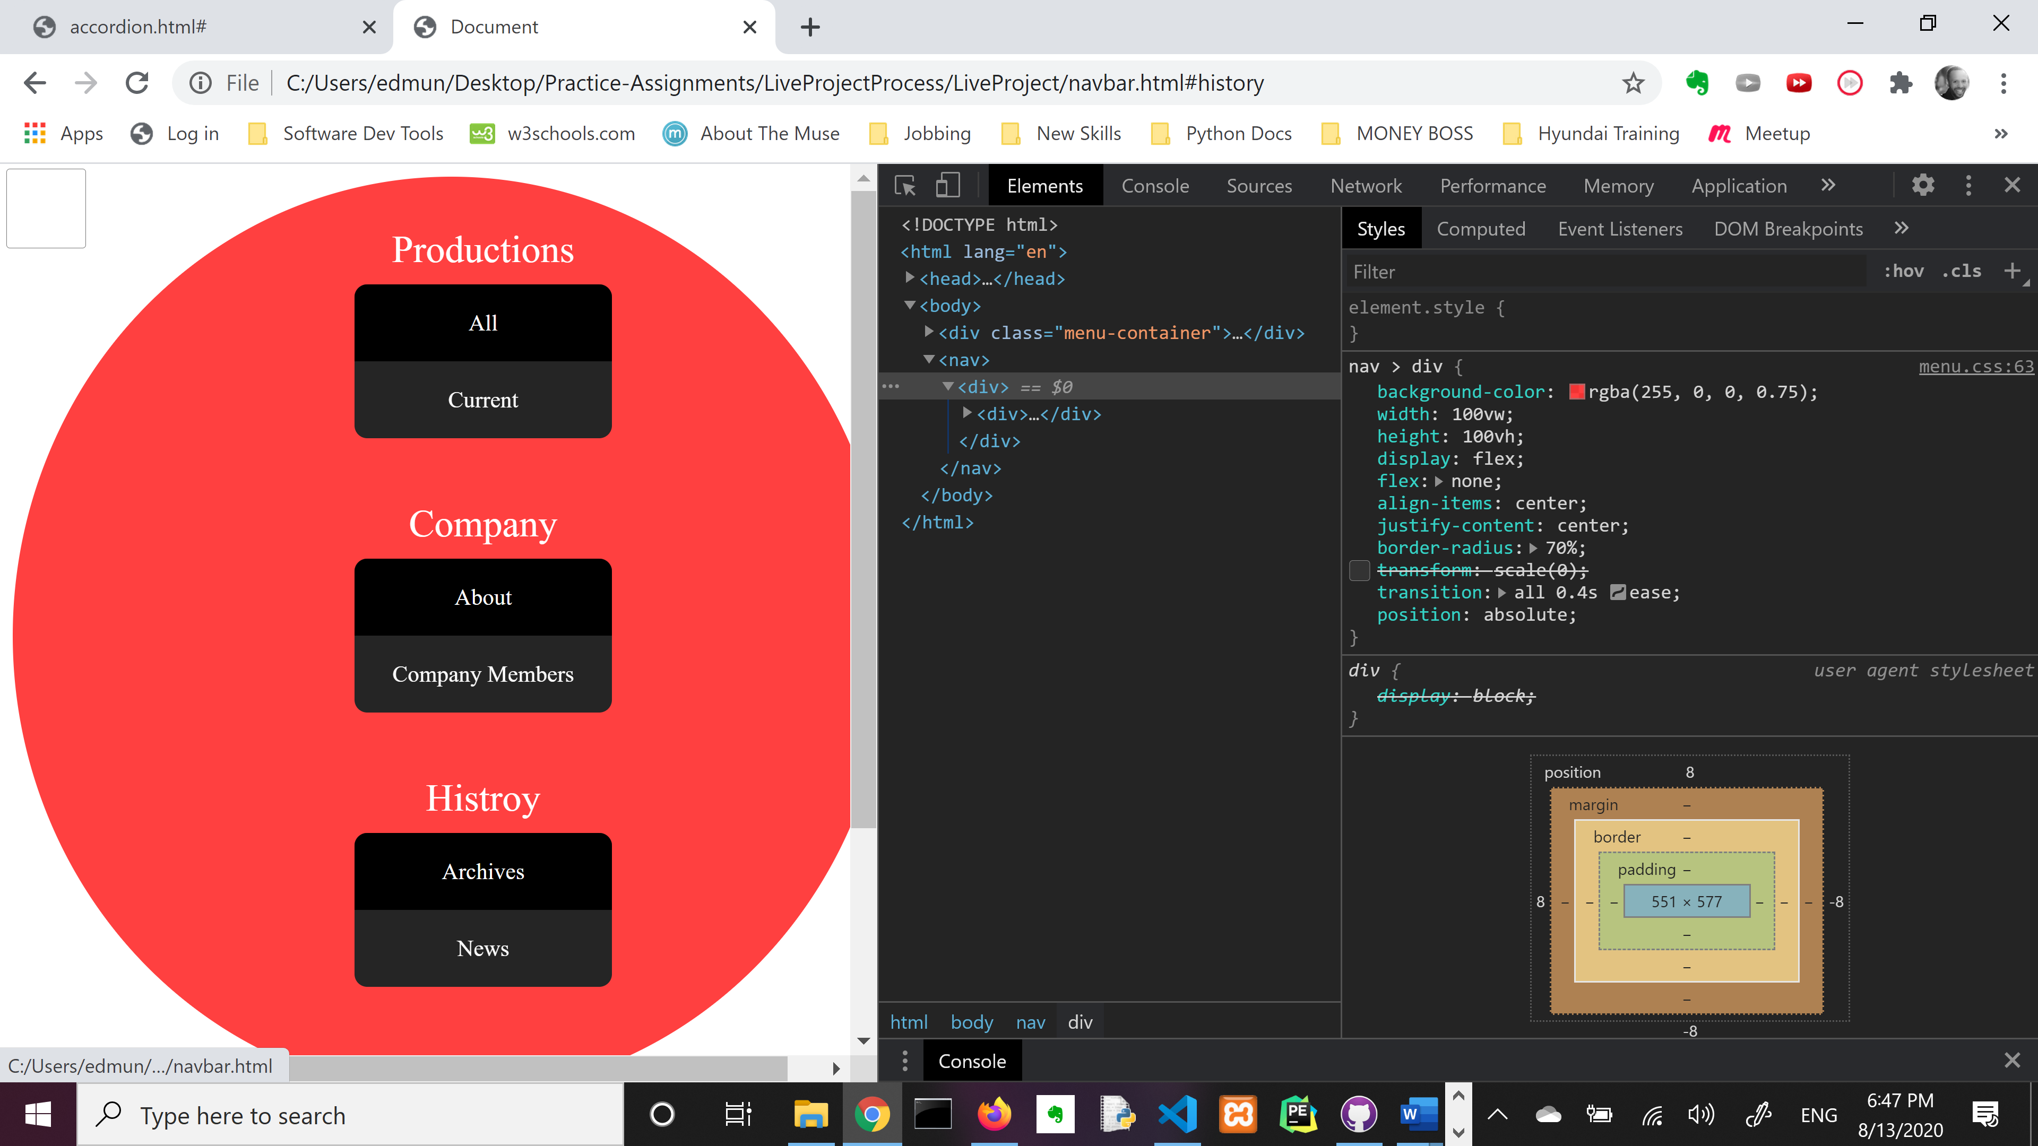
Designing in a code-first MVC Environment
A Beautician Amongst Surgeons
Edmund Alyn Jones

Slide 2
Styling and UI in ASP.NET is like trying to paint a mural where you have to go on a scavenger hunt to find all the walls.
- me

Slide 3
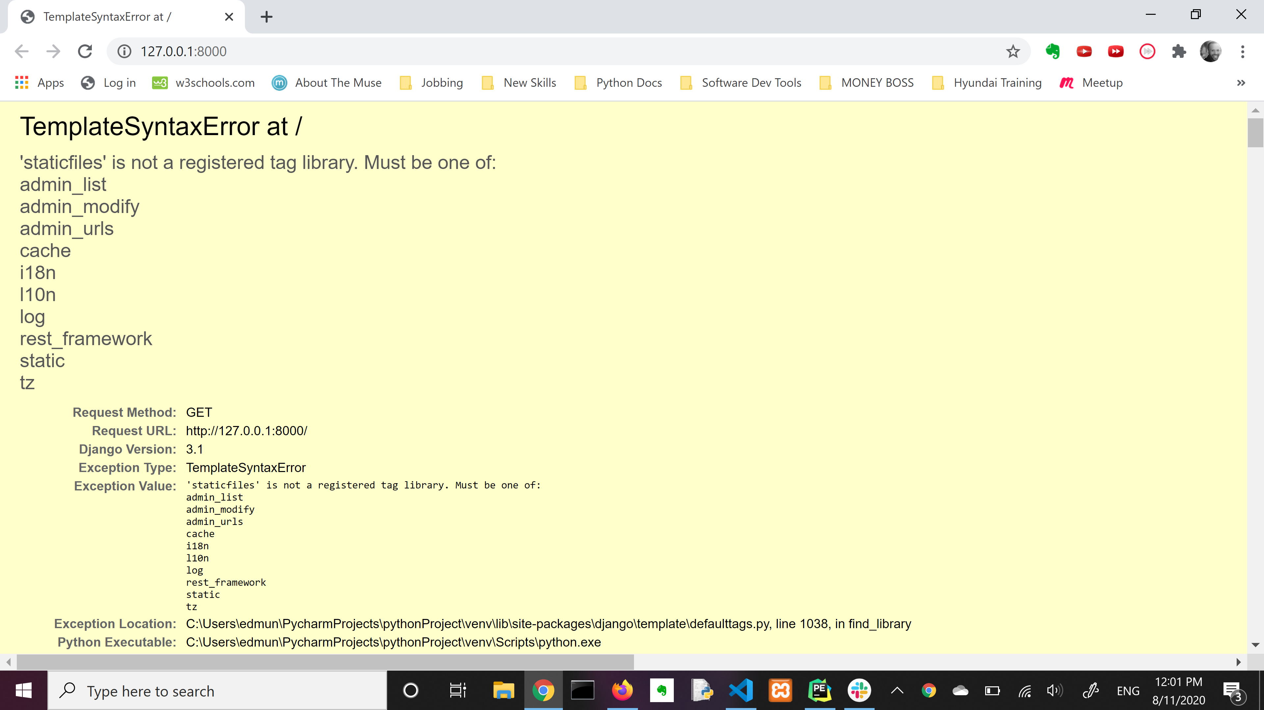
Welcome to your first day on a framework. Here’s an error you don’t understand yet to get you started!

Slide 4
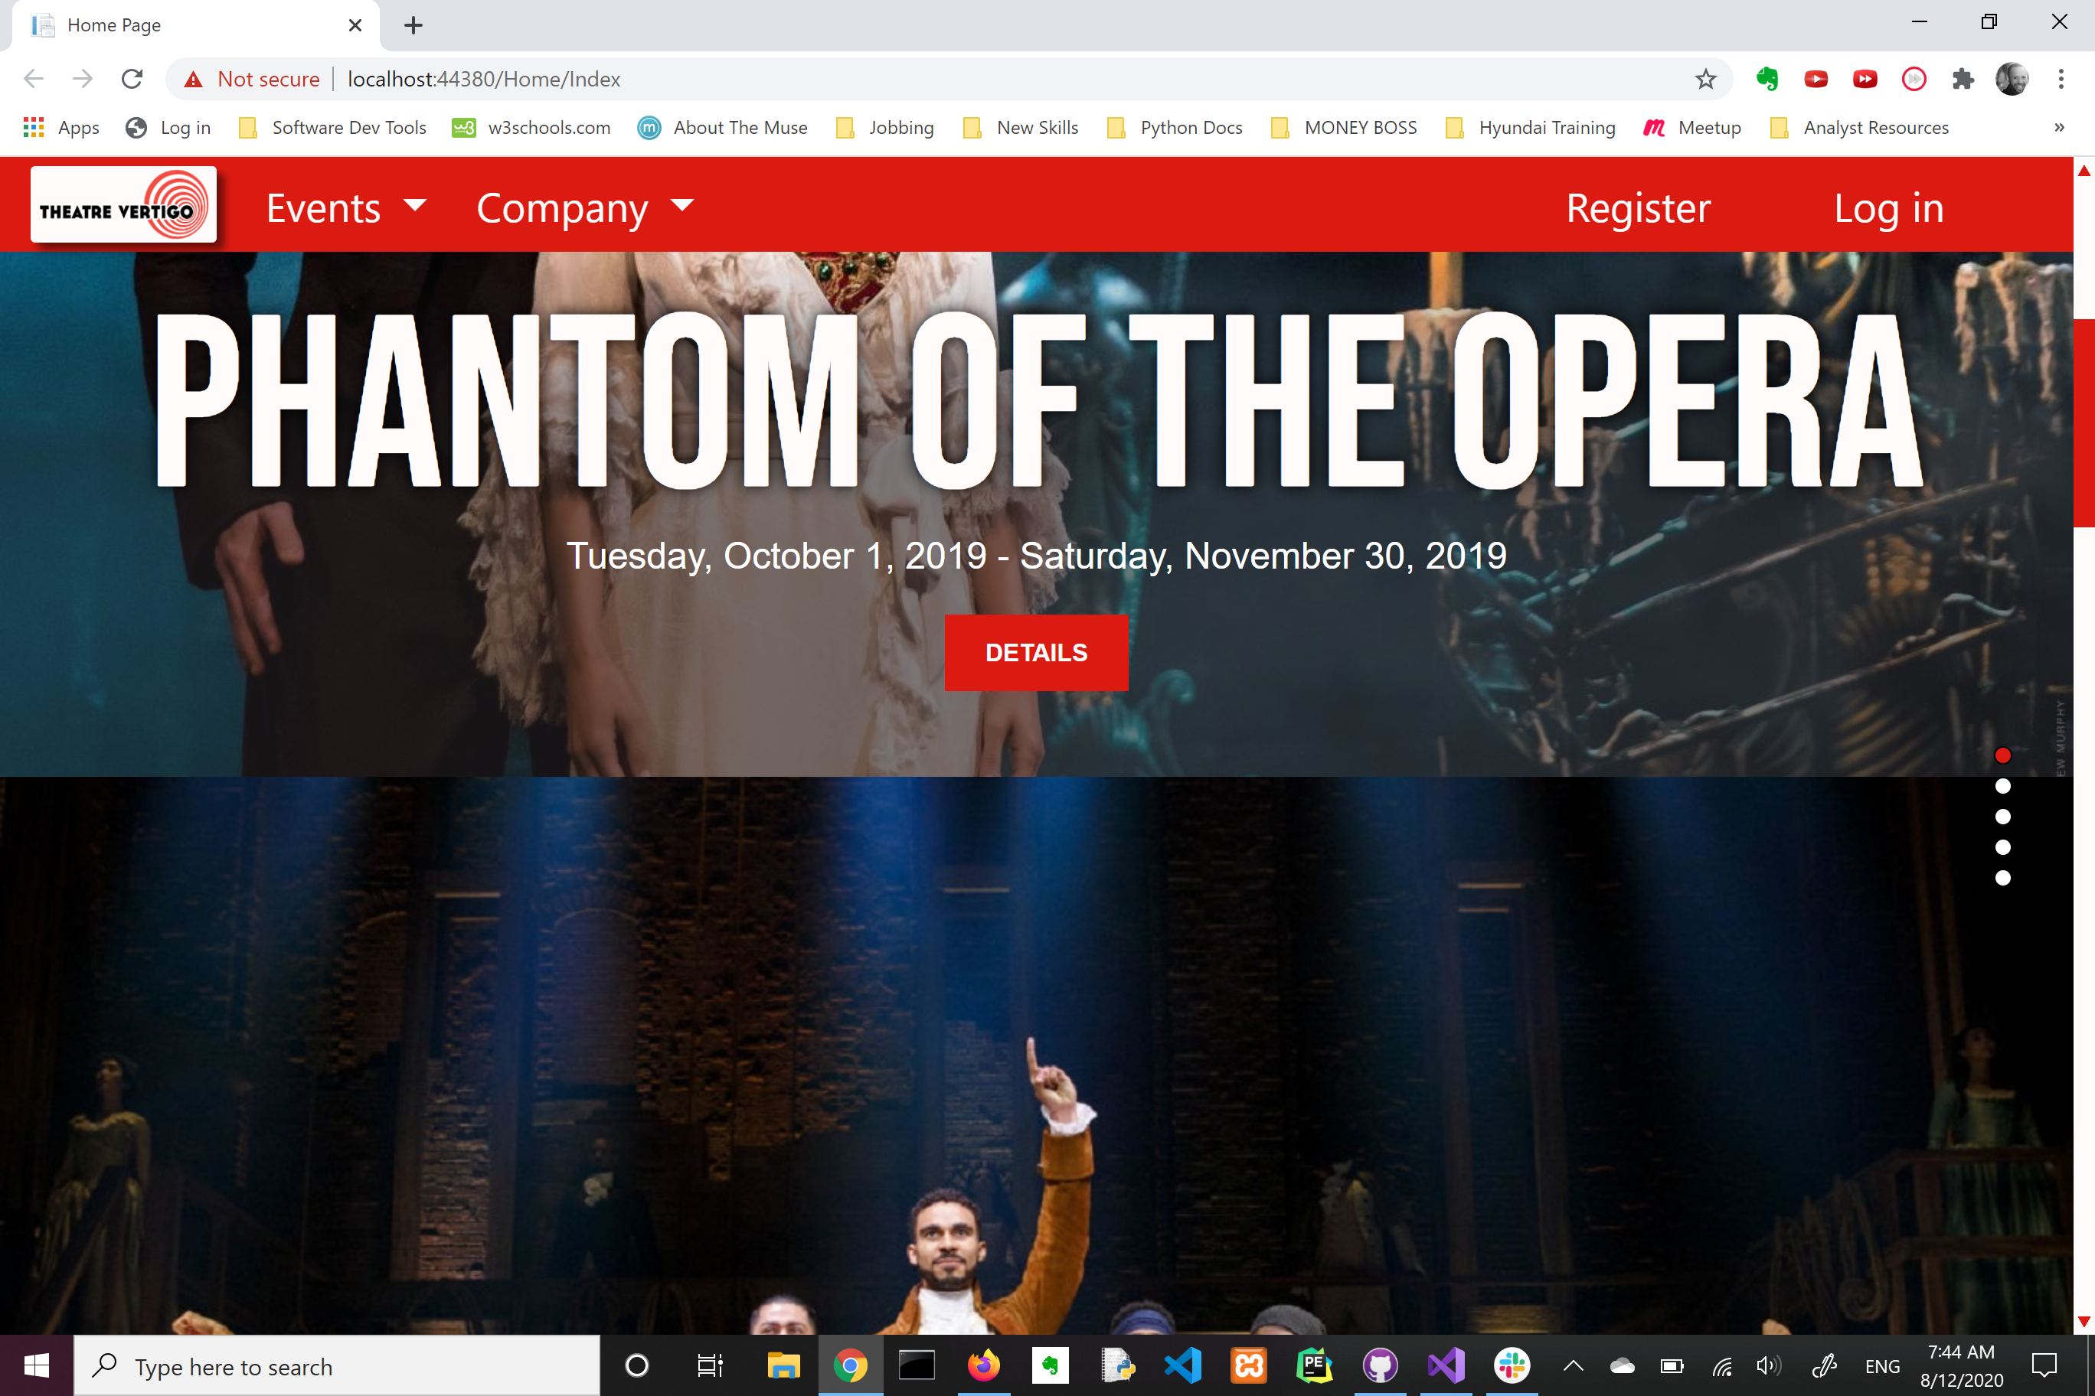
Little Victories

Slide 5
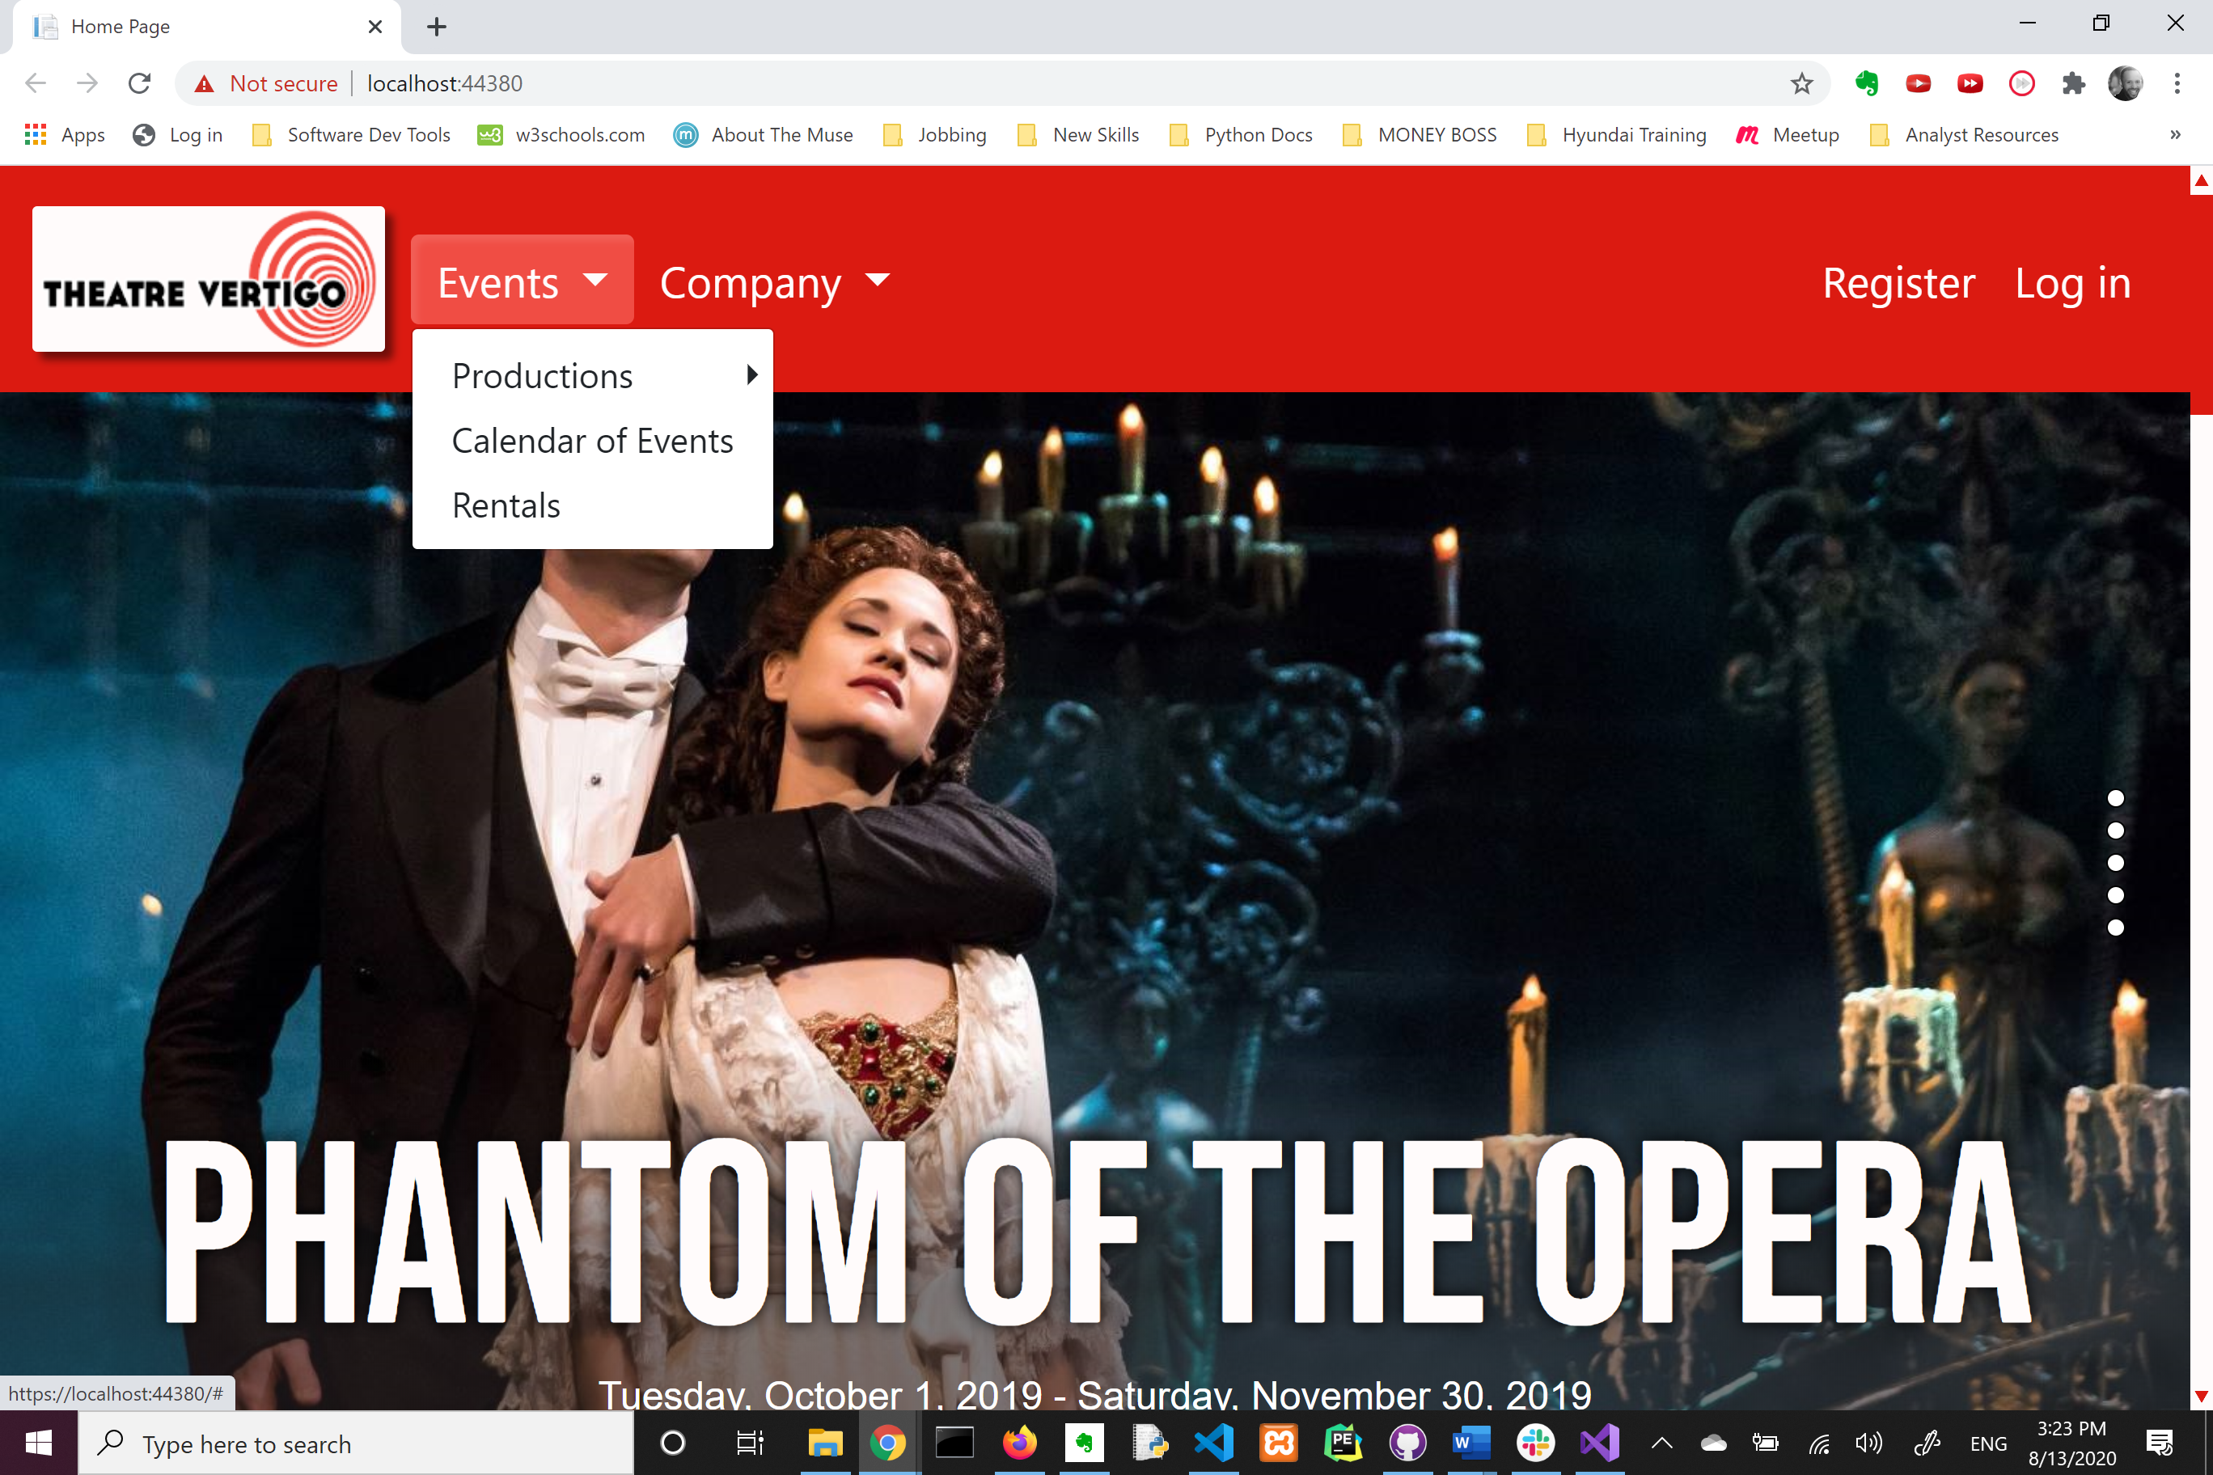
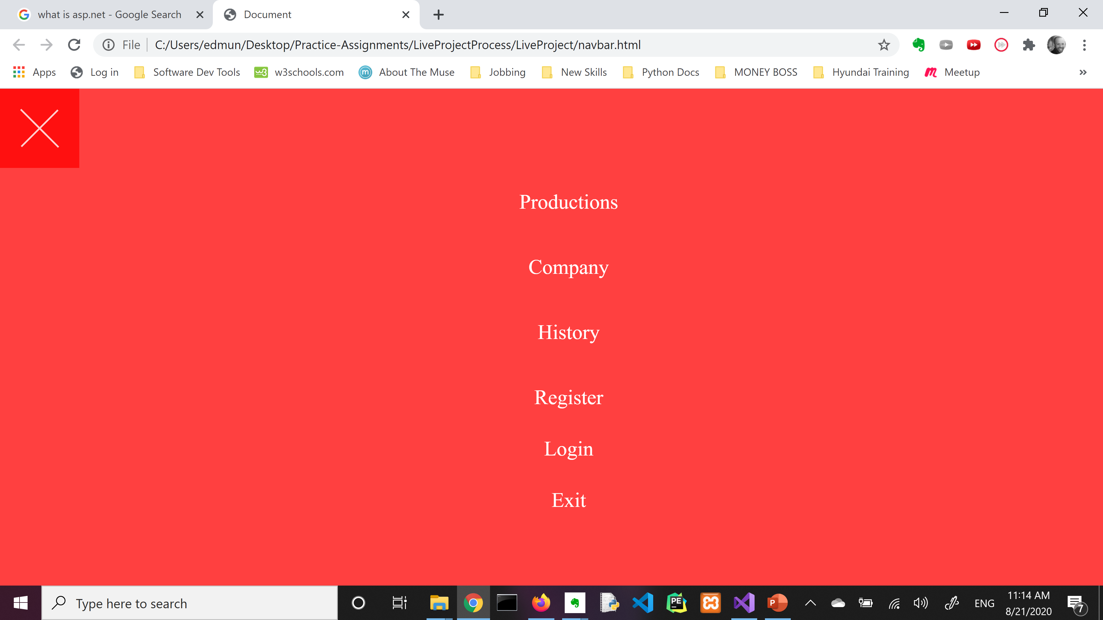
The Navbar and I

Slide 6
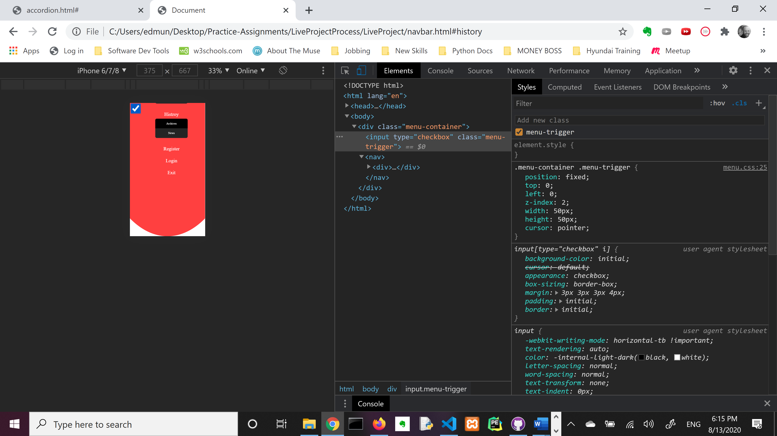
#mobile-first
I was taught by the YouTubes to build mobile first.
So I started this project by always prototyping an idea before trying to add to the CMS project.
Here you can see I am already having issues with positioning and covering the screen properly with the overlay.
This theme will be ongoing!

Slide 7
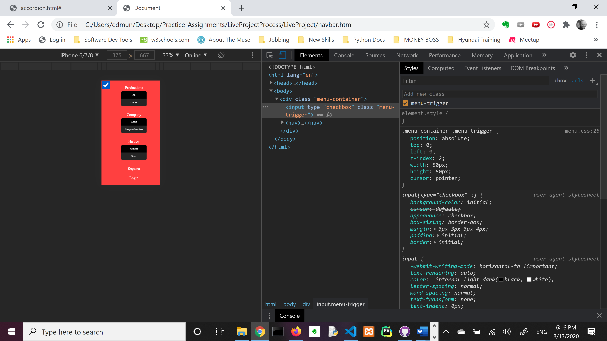
It worked so good on mobile. What happened?

Slide 8
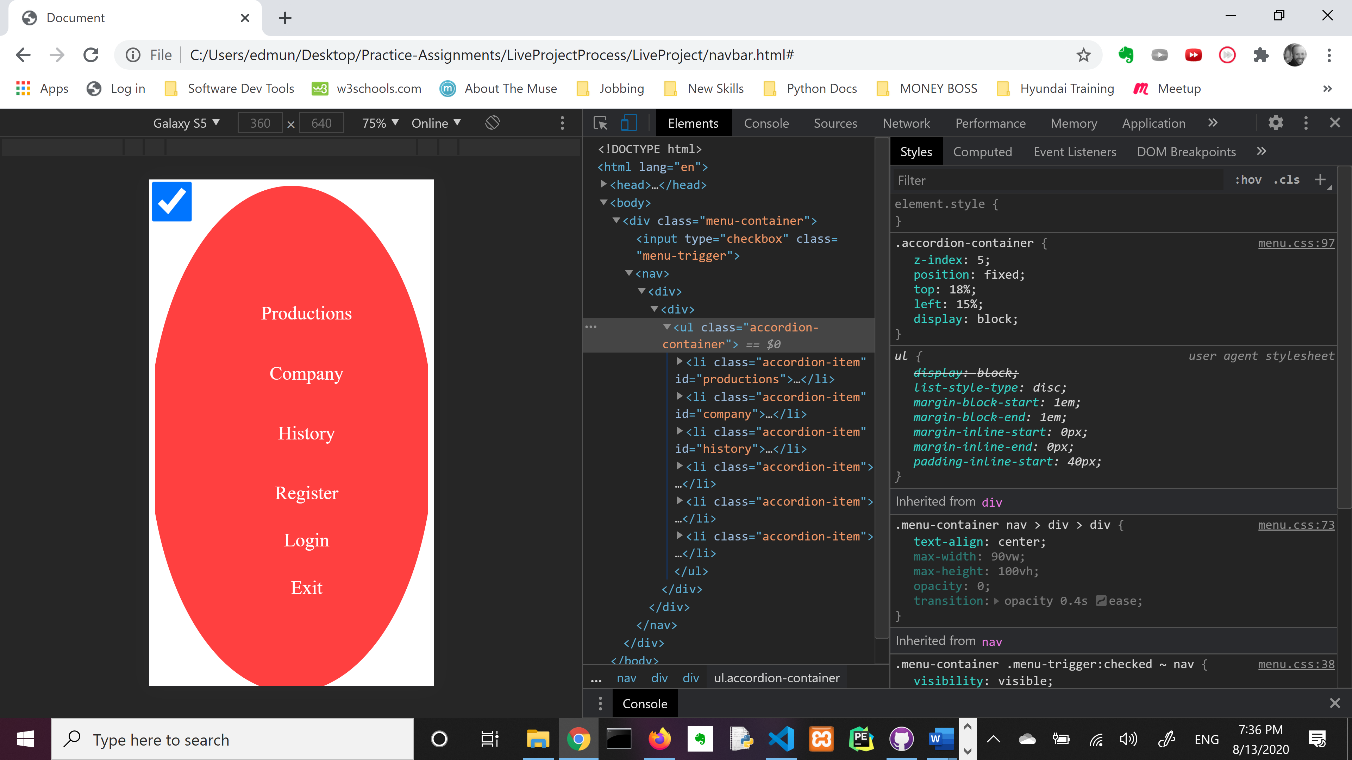
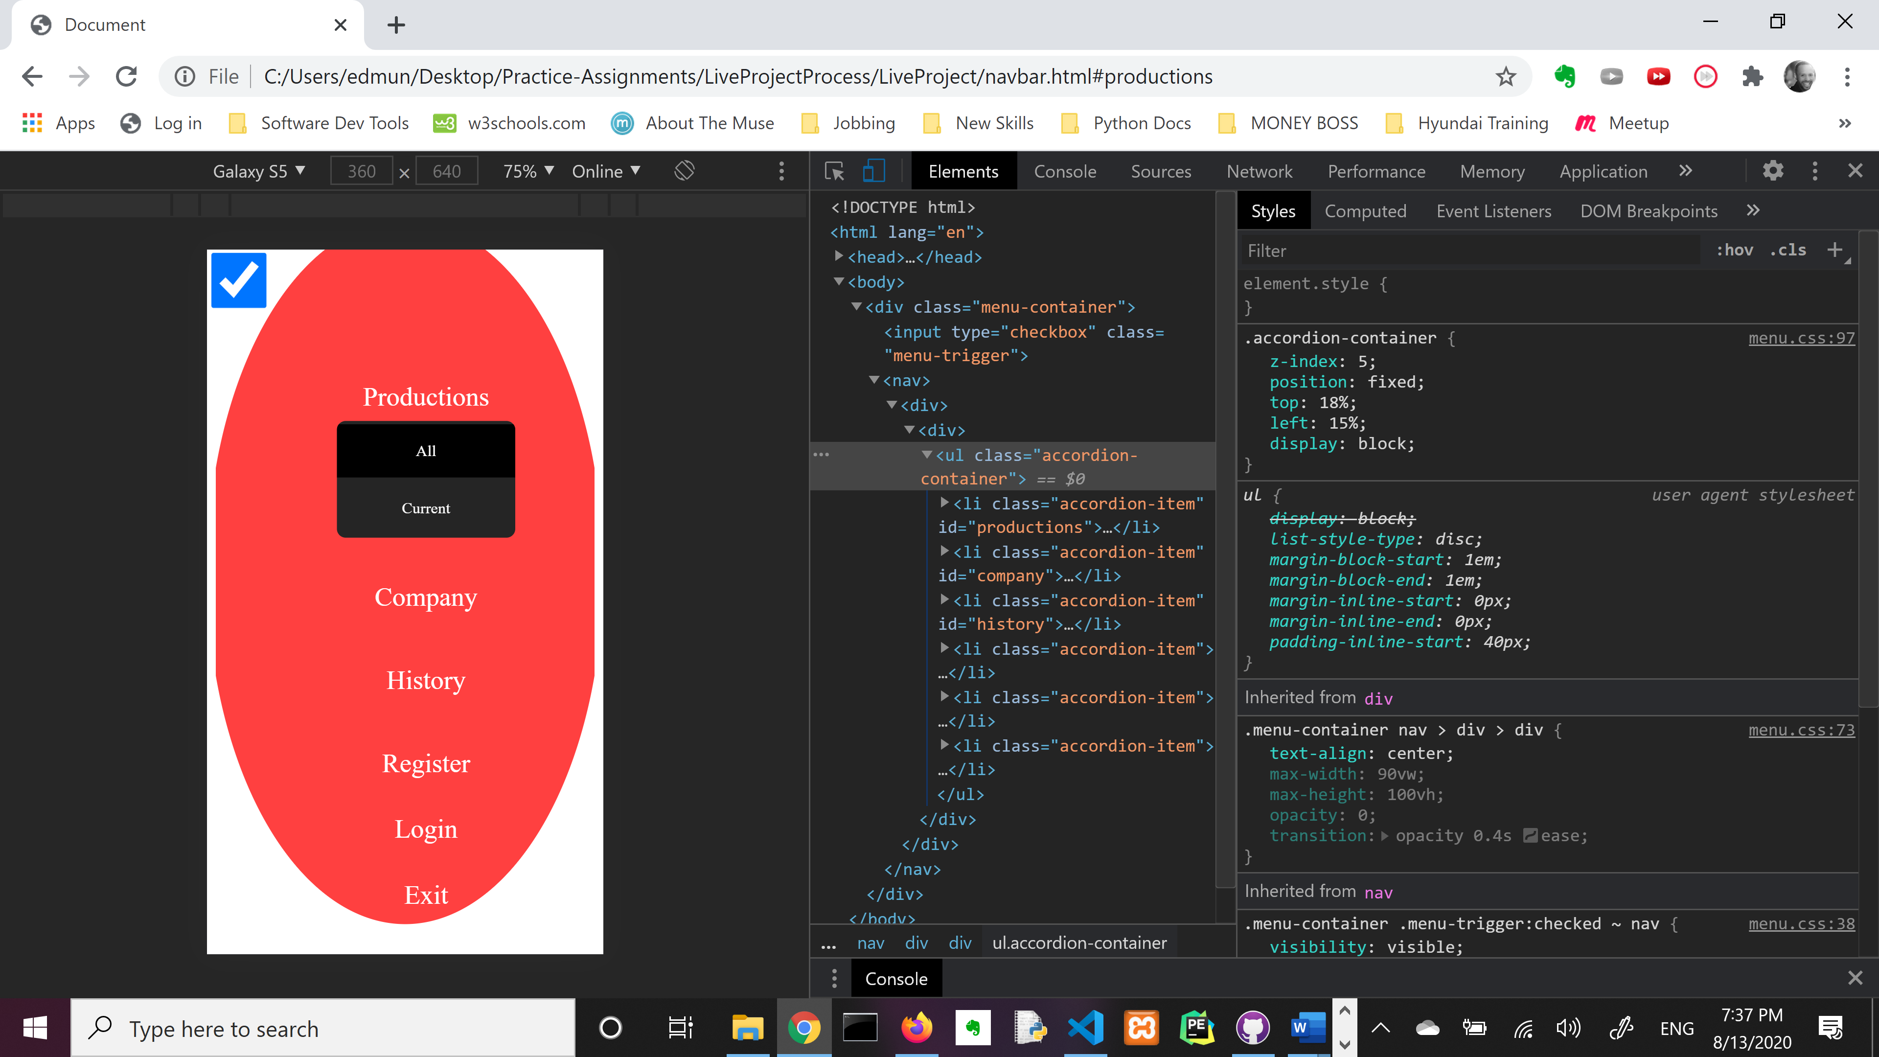
First the menu. Then the drop-down items.

Slide 9
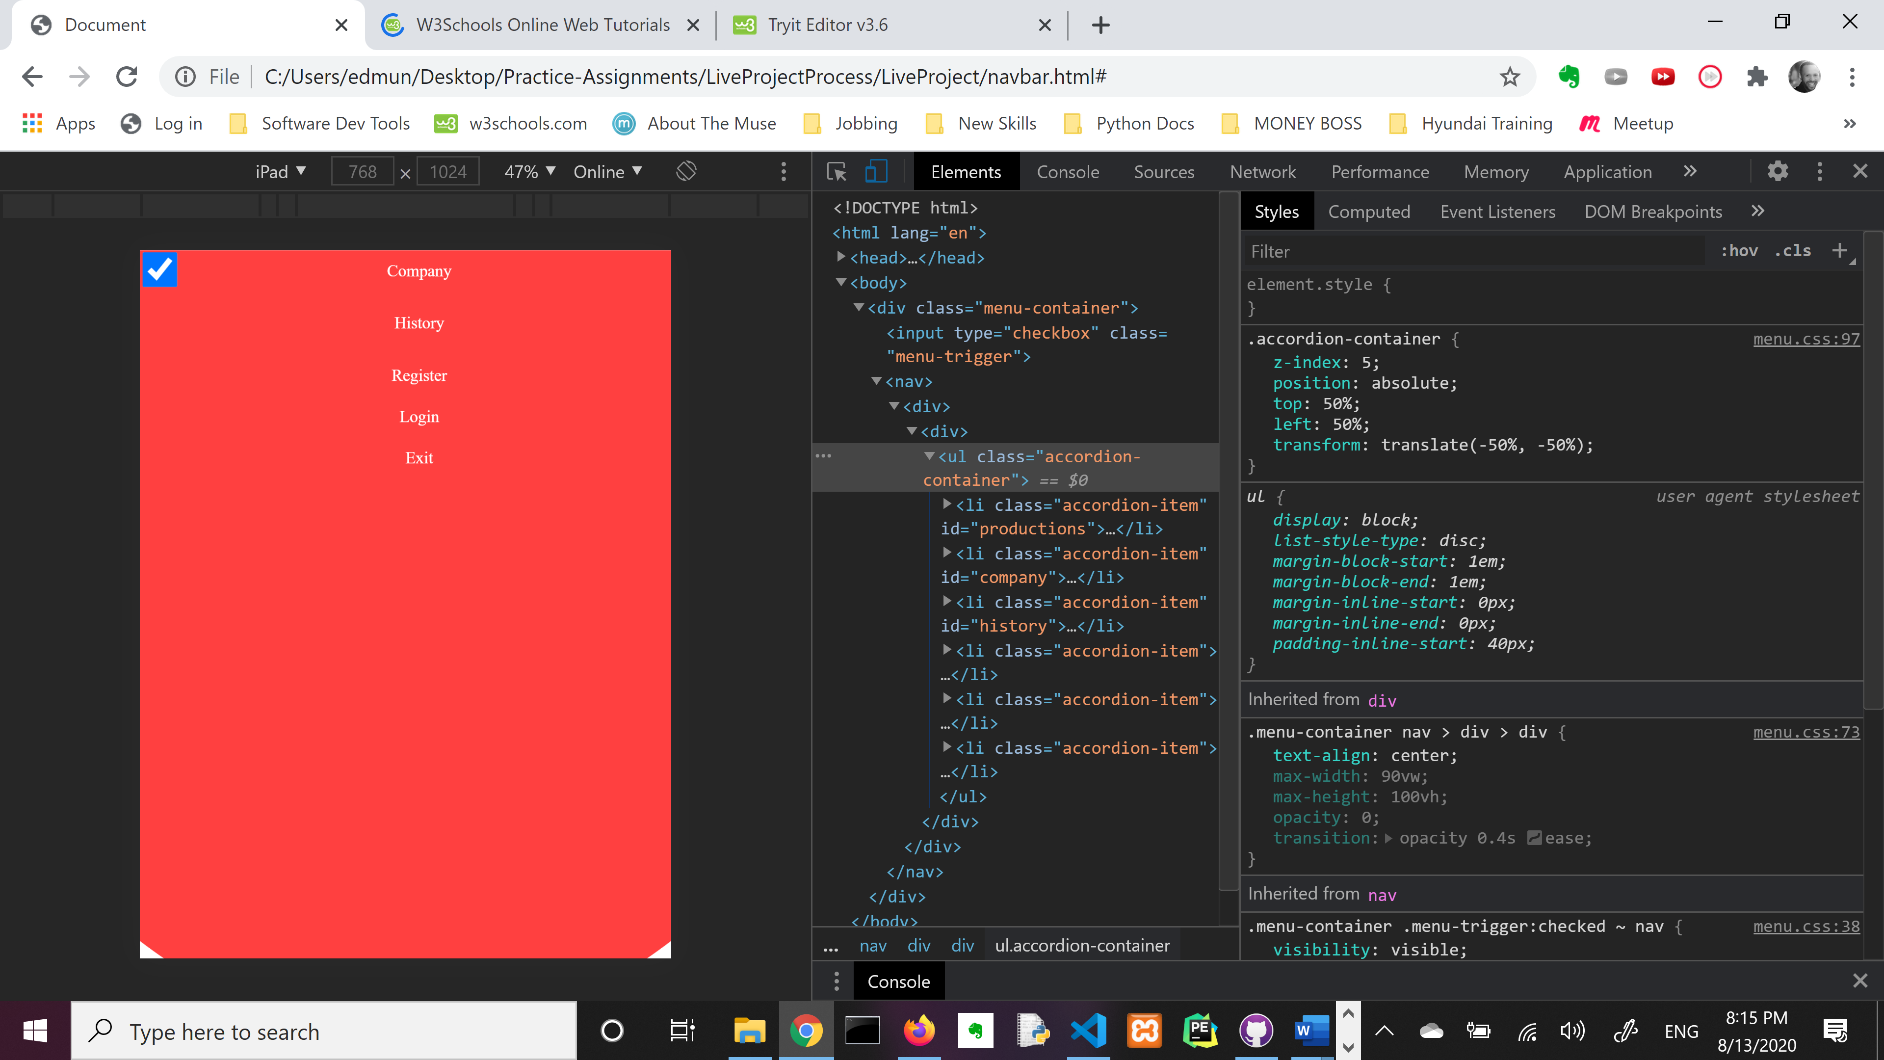
One step forward…
We finally covered the screen but now I can’t read the text.
Yay!

Slide 10
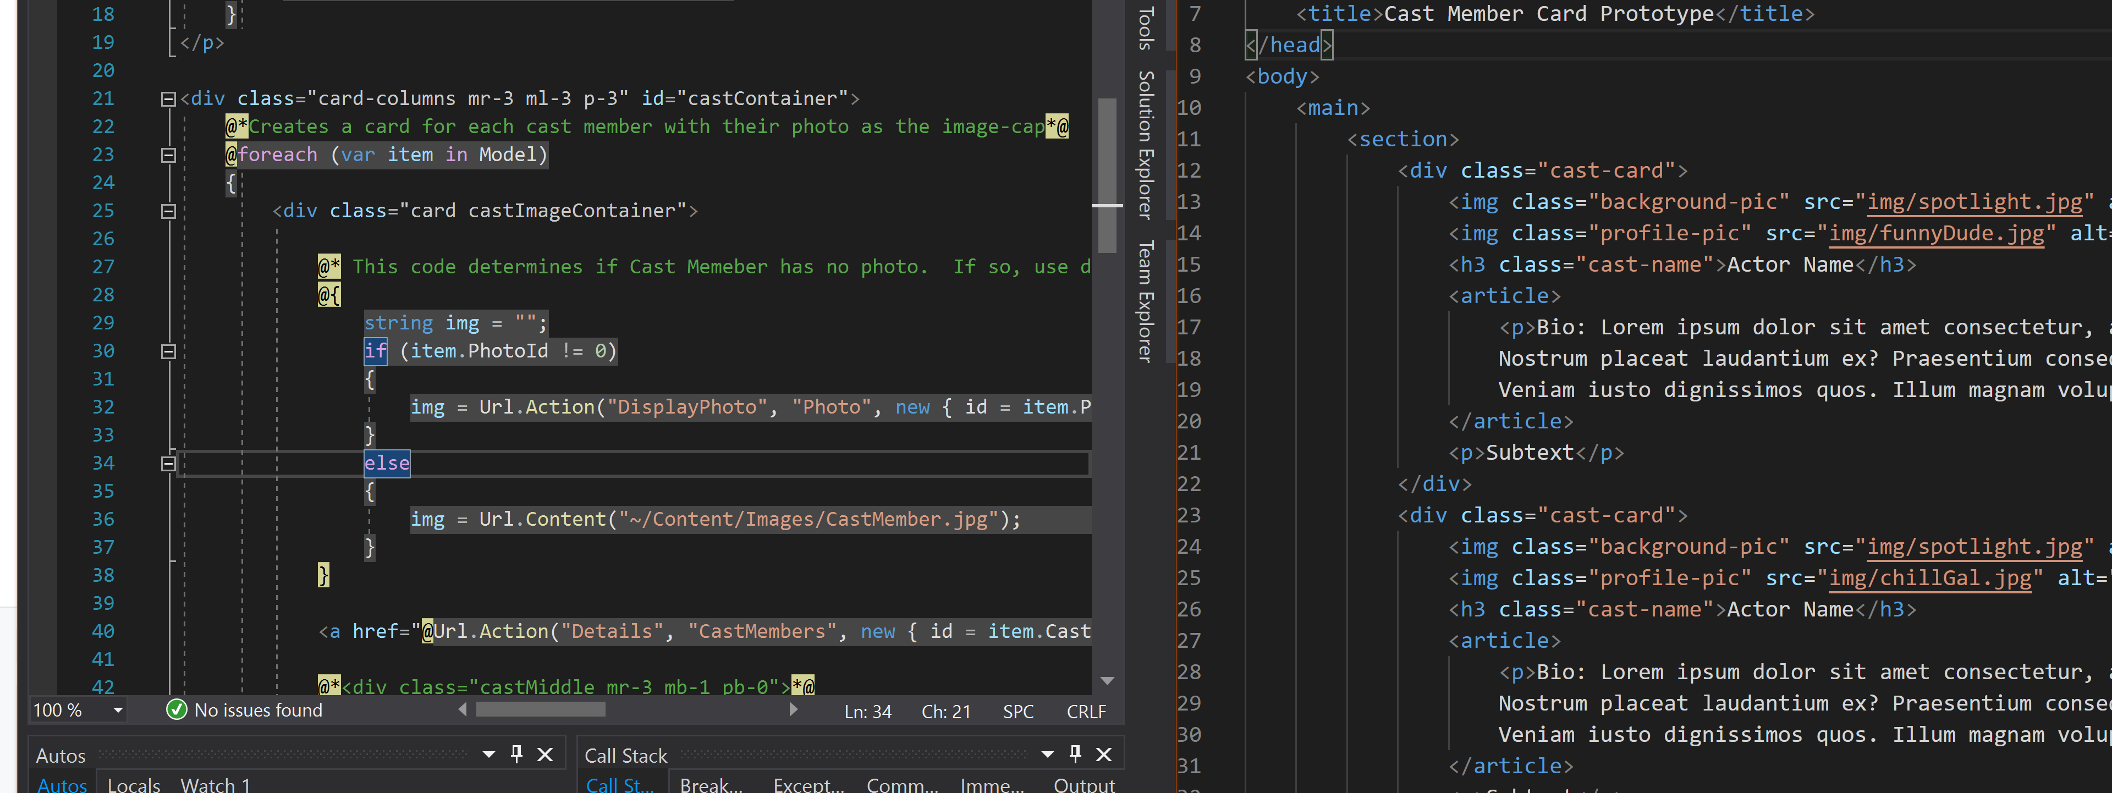
Square Peg, Round Hole
How do I get my prototypes to fit into the project without breaking everything?

Slide 11
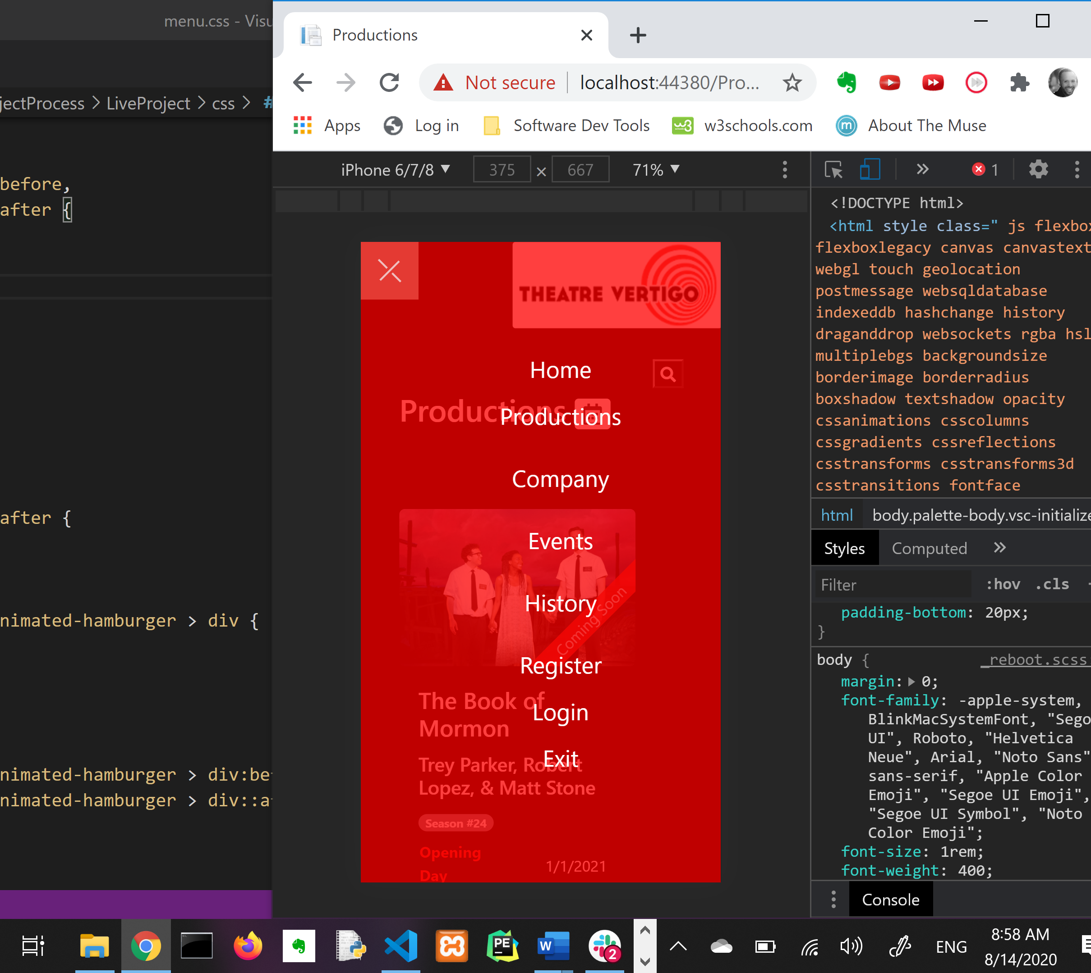
Make it Work!
After working to get my prototype up and running, it was now time to add it to the actual project.
The prototyping has helped as you can see I can cover the screen nicely now.
This, however, doesn’t have the accordion-style drop down menu yet.

Slide 12
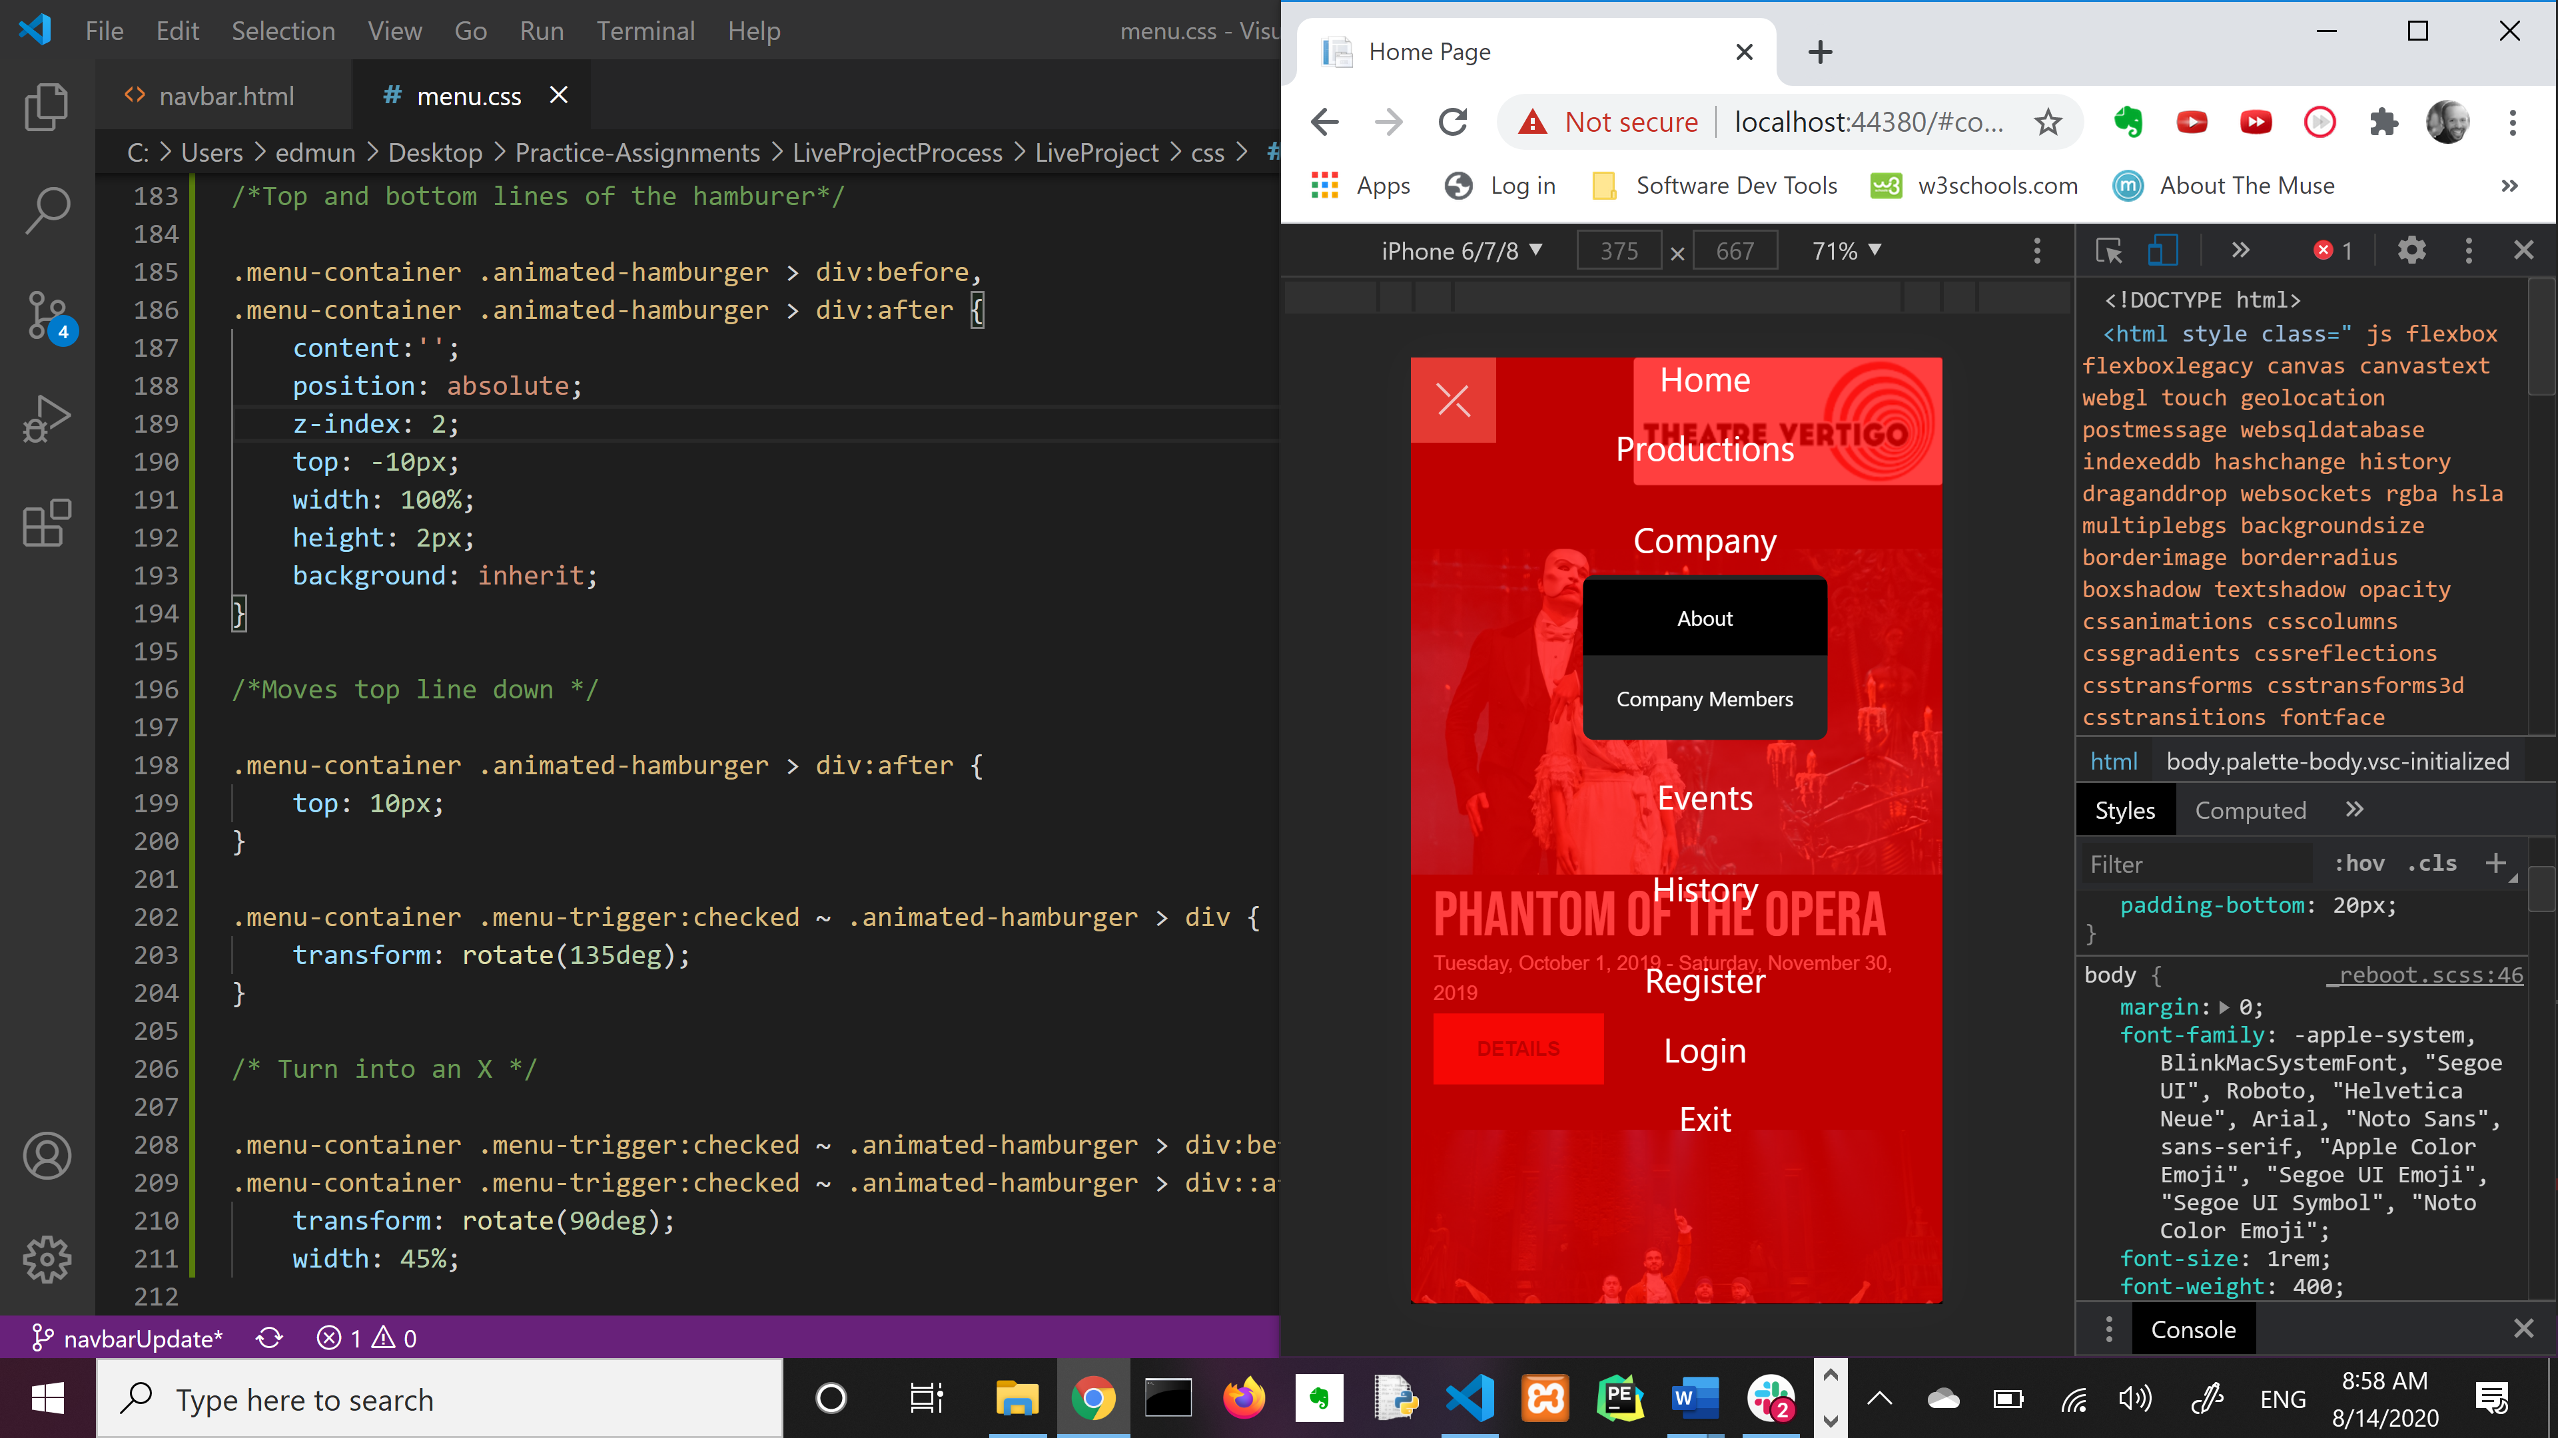
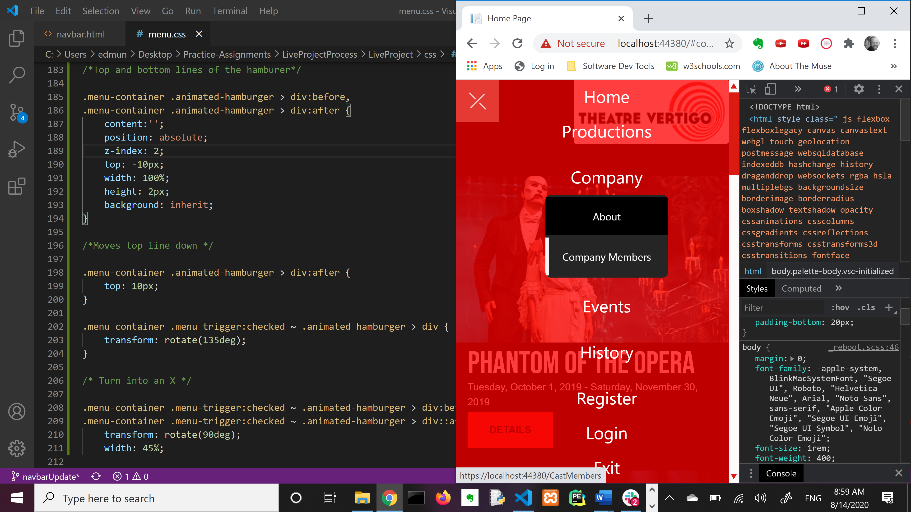
The drop down is born
Drop down taking shape
Add some styling on hover

Slide 13
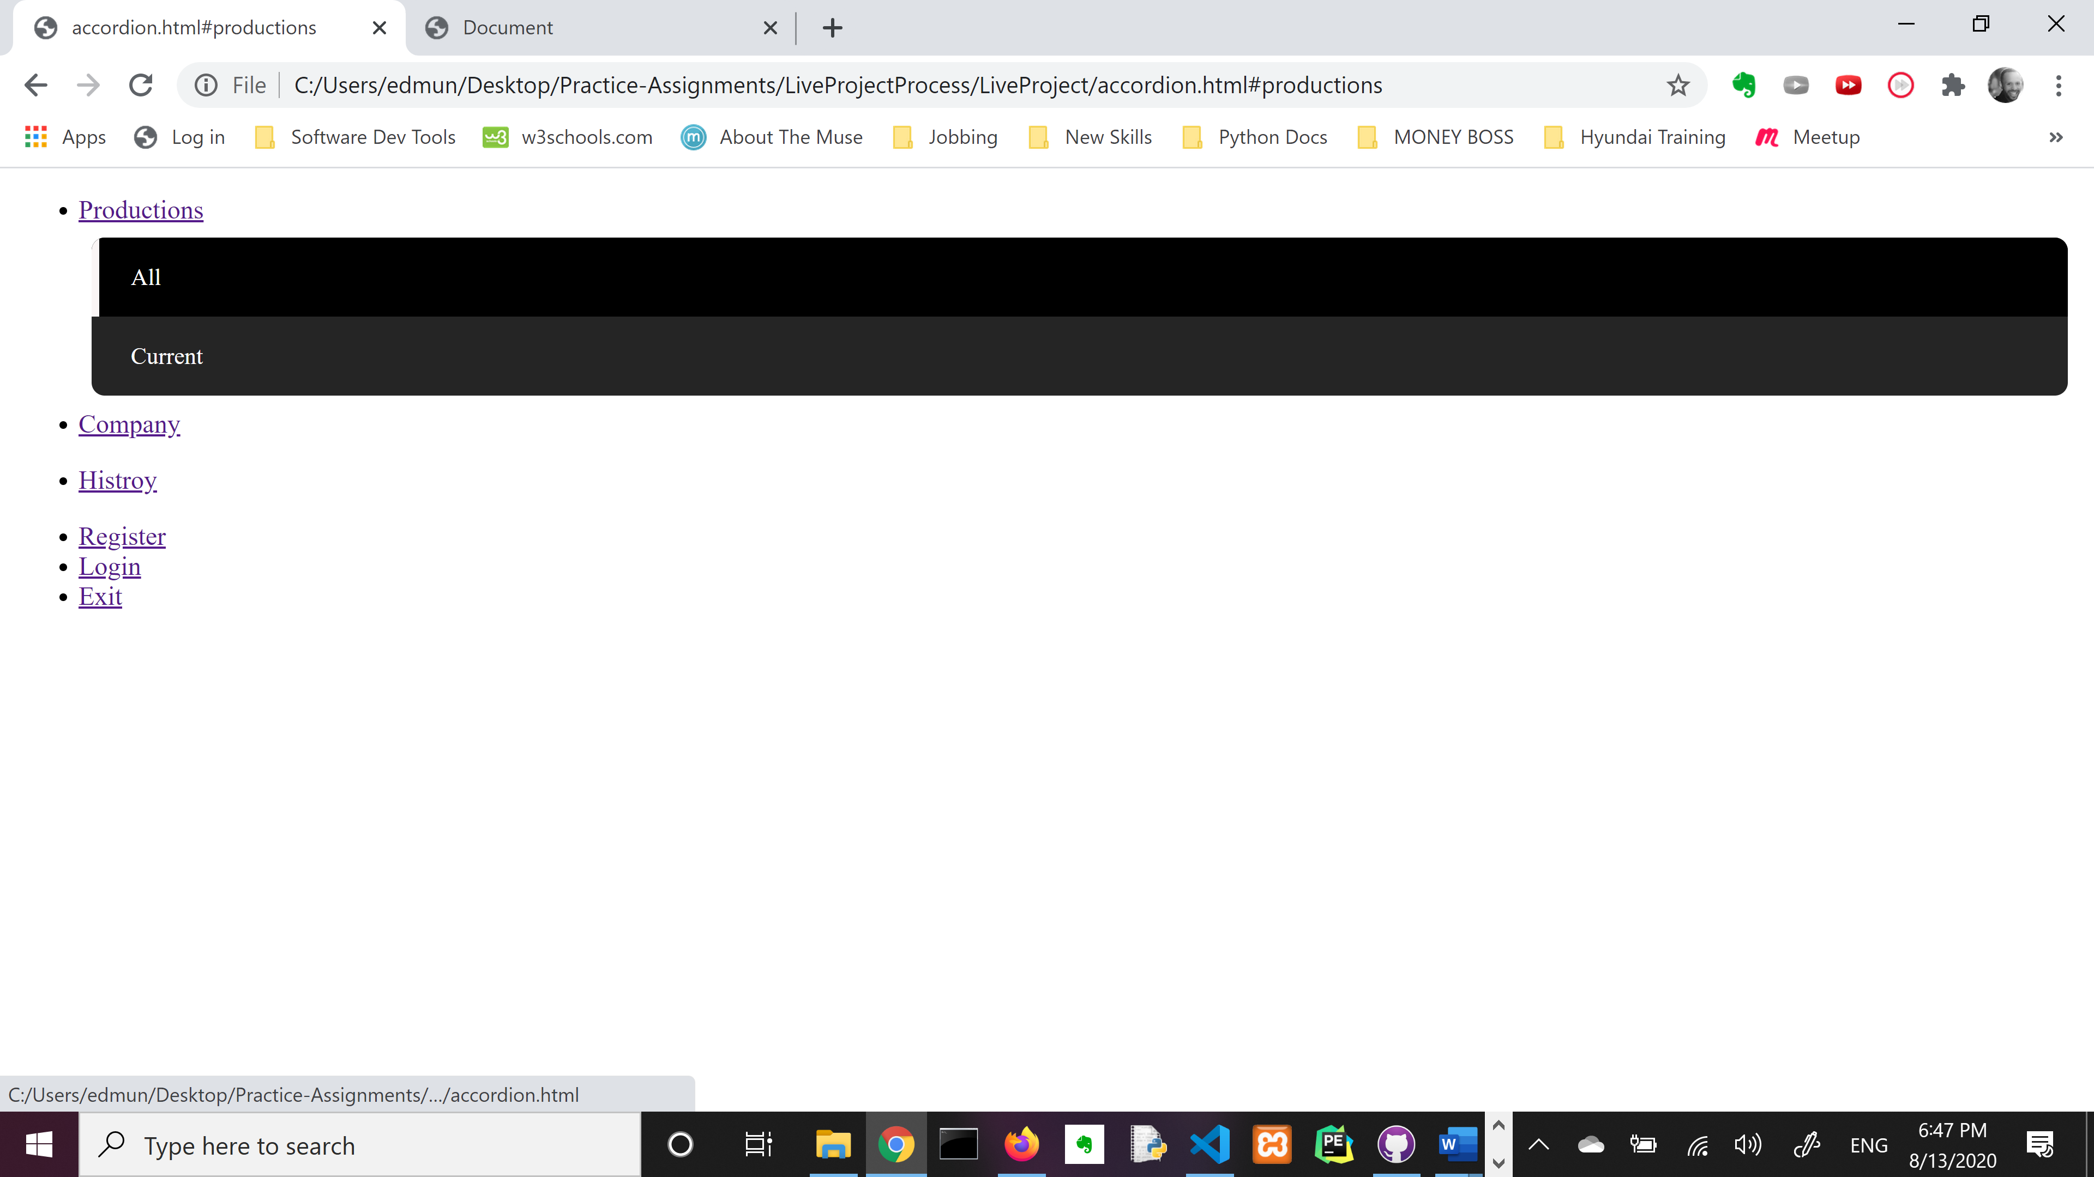
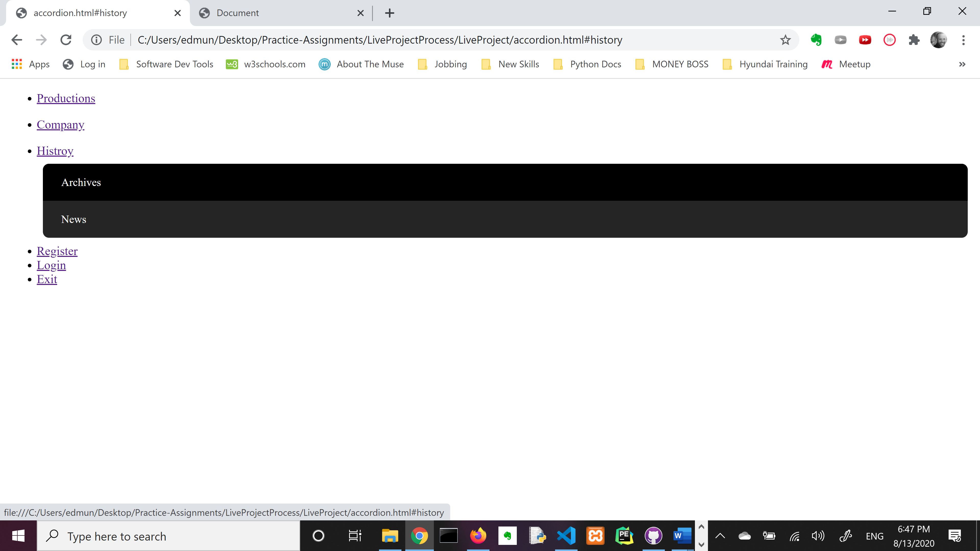
Prototyping without Style

Slide 14
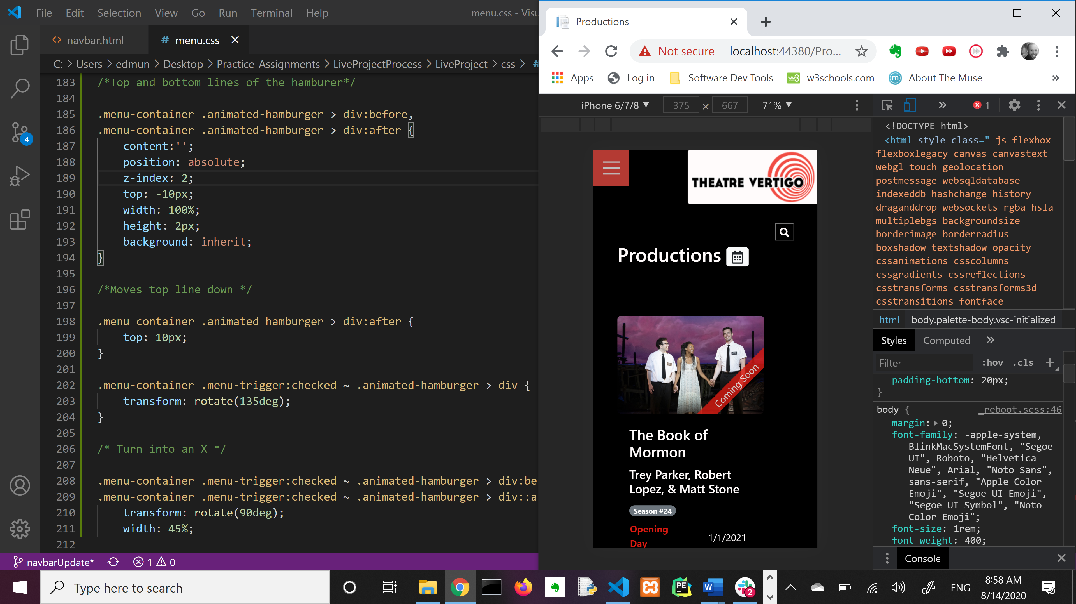
Looking Good on Mobile

Slide 15
Yeah, it’s cute and all but can the client run admin functionality!
Oh, you still wanted to be able to do that?

Slide 16
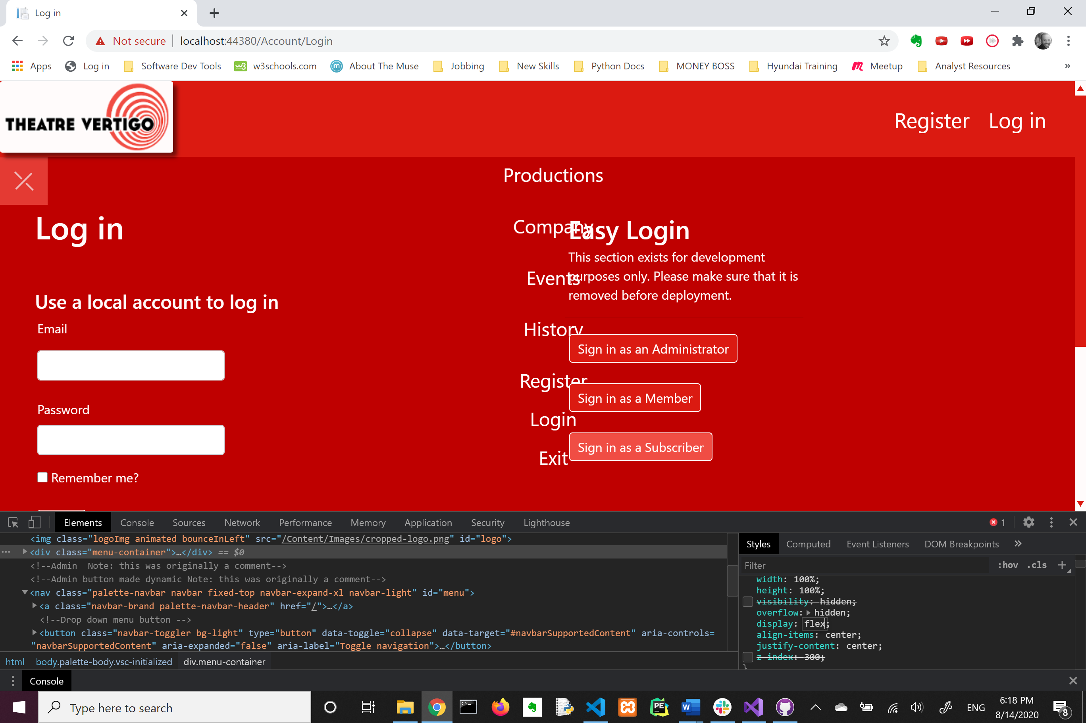
Nope
Your login is blocking my amazing overlay navigation display!
Now, we descend into position/z-index hell for several hours!

Slide 17
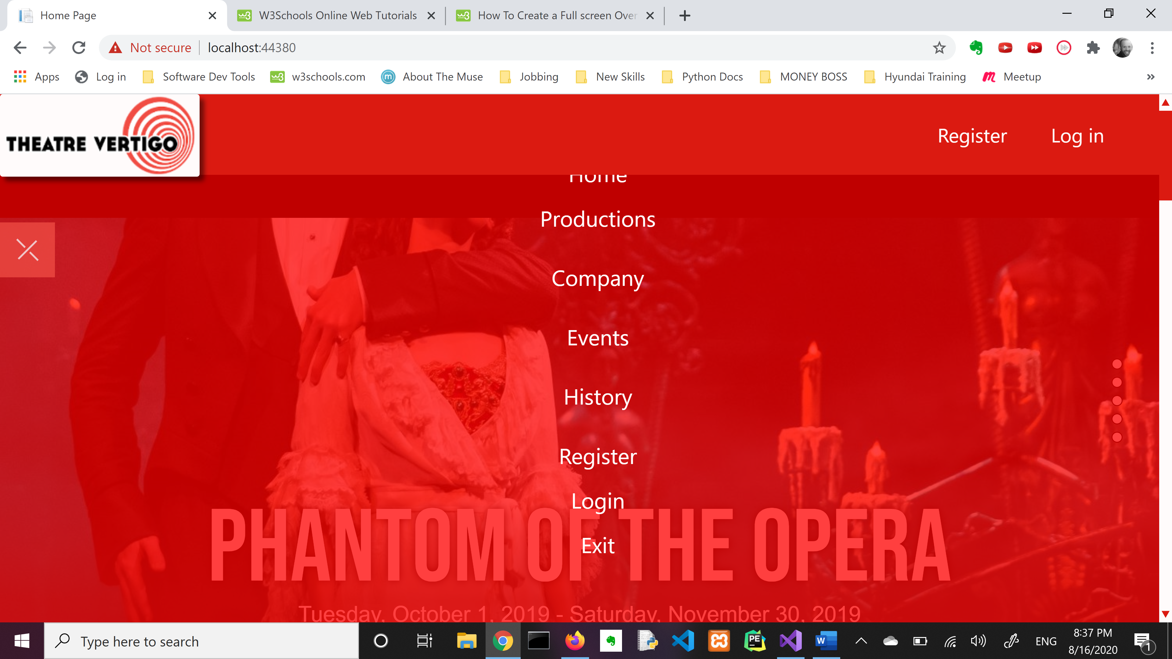
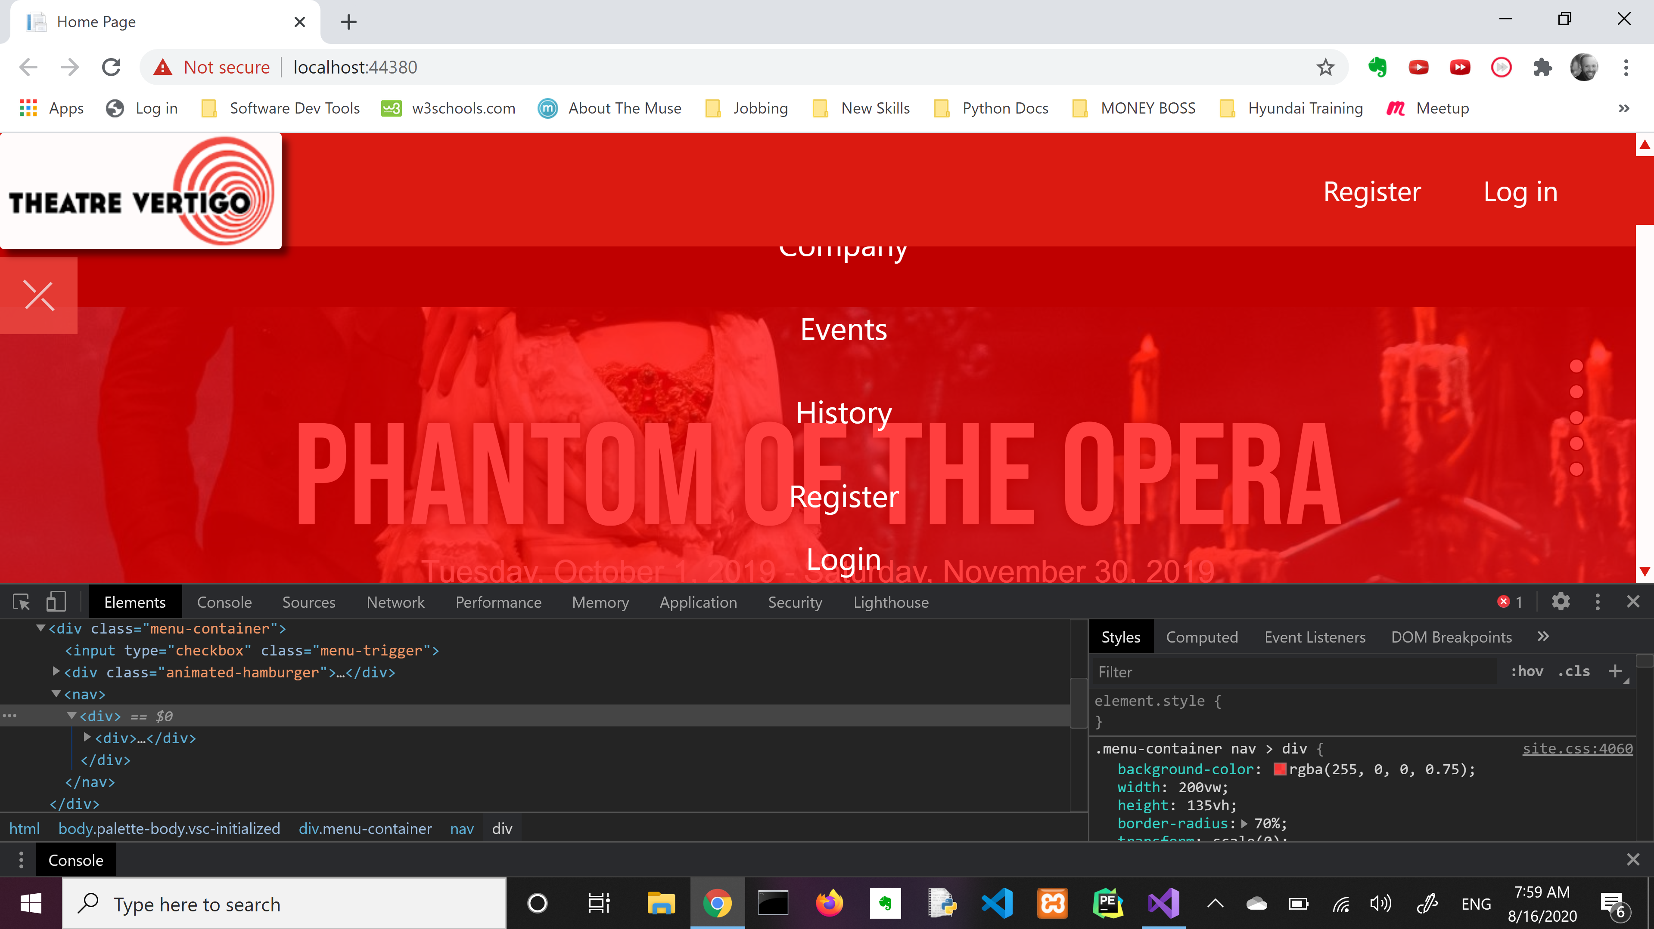
Registration and Login meet Overlay

Slide 18
I had not figured out how to re-introduce the Register and Log in buttons from the original navbar.
That’s because I could not find the HTML that housed these little buggers. So I tried to shoe-horn it into my overlay design with much failure.

Slide 19
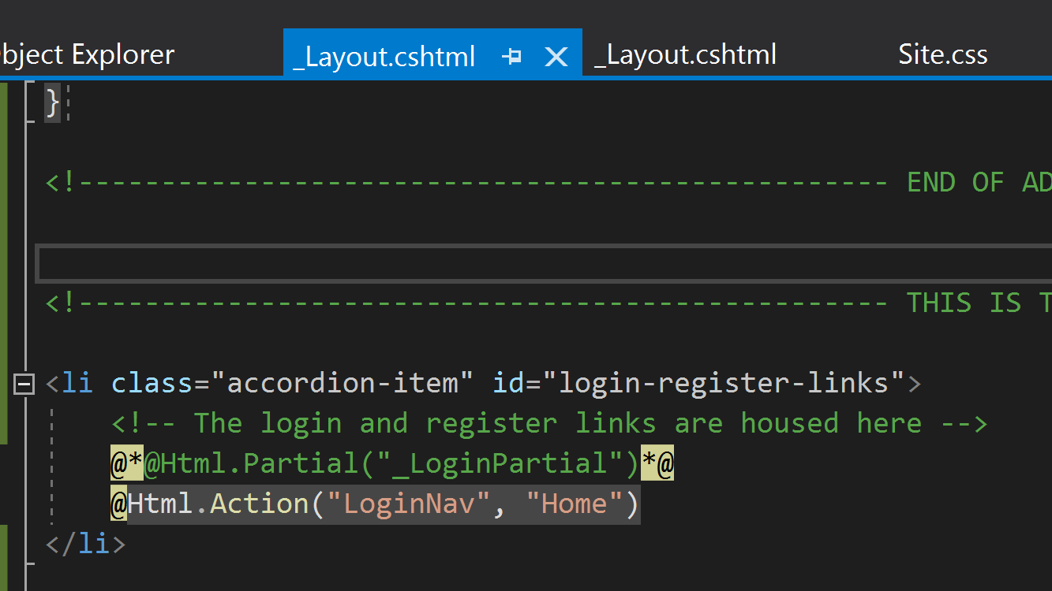
They were right here all along. Scavenger hunt complete.

Slide 20
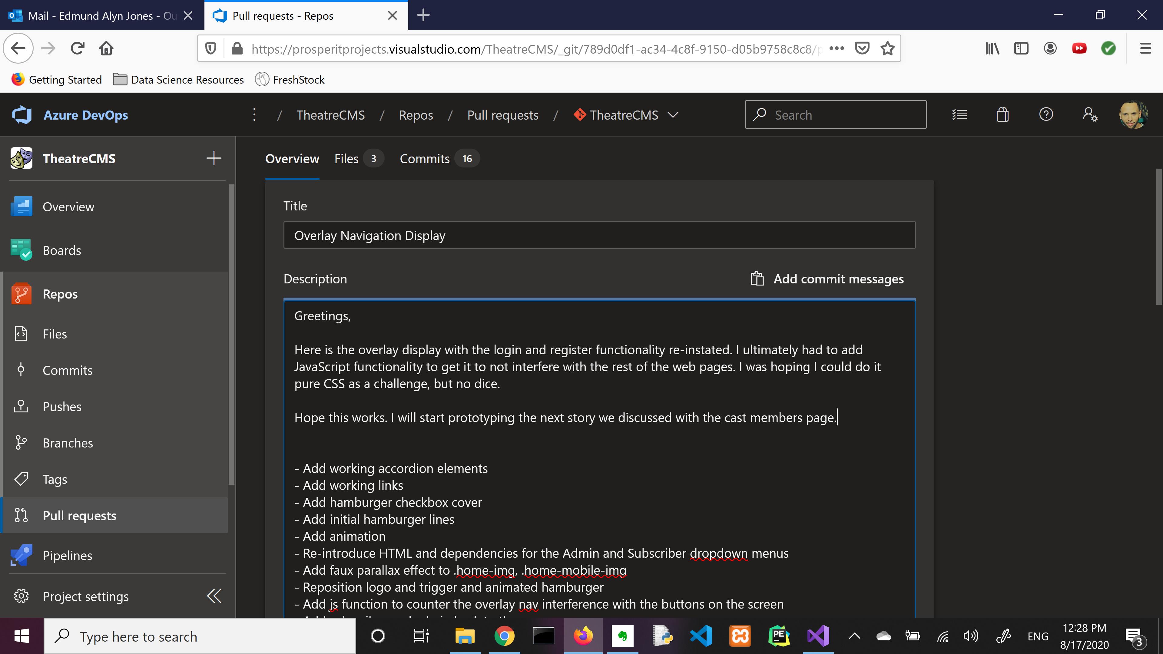
Time to show the boss the finished product!
I thought I could turn in the overlay display with the re-introduced Log in and Register buttons from the original navbar.
It was working.
So, I decided to tackle a second story.

Slide 21
We’re not done with the navbar though.
-Alan yu

Slide 22
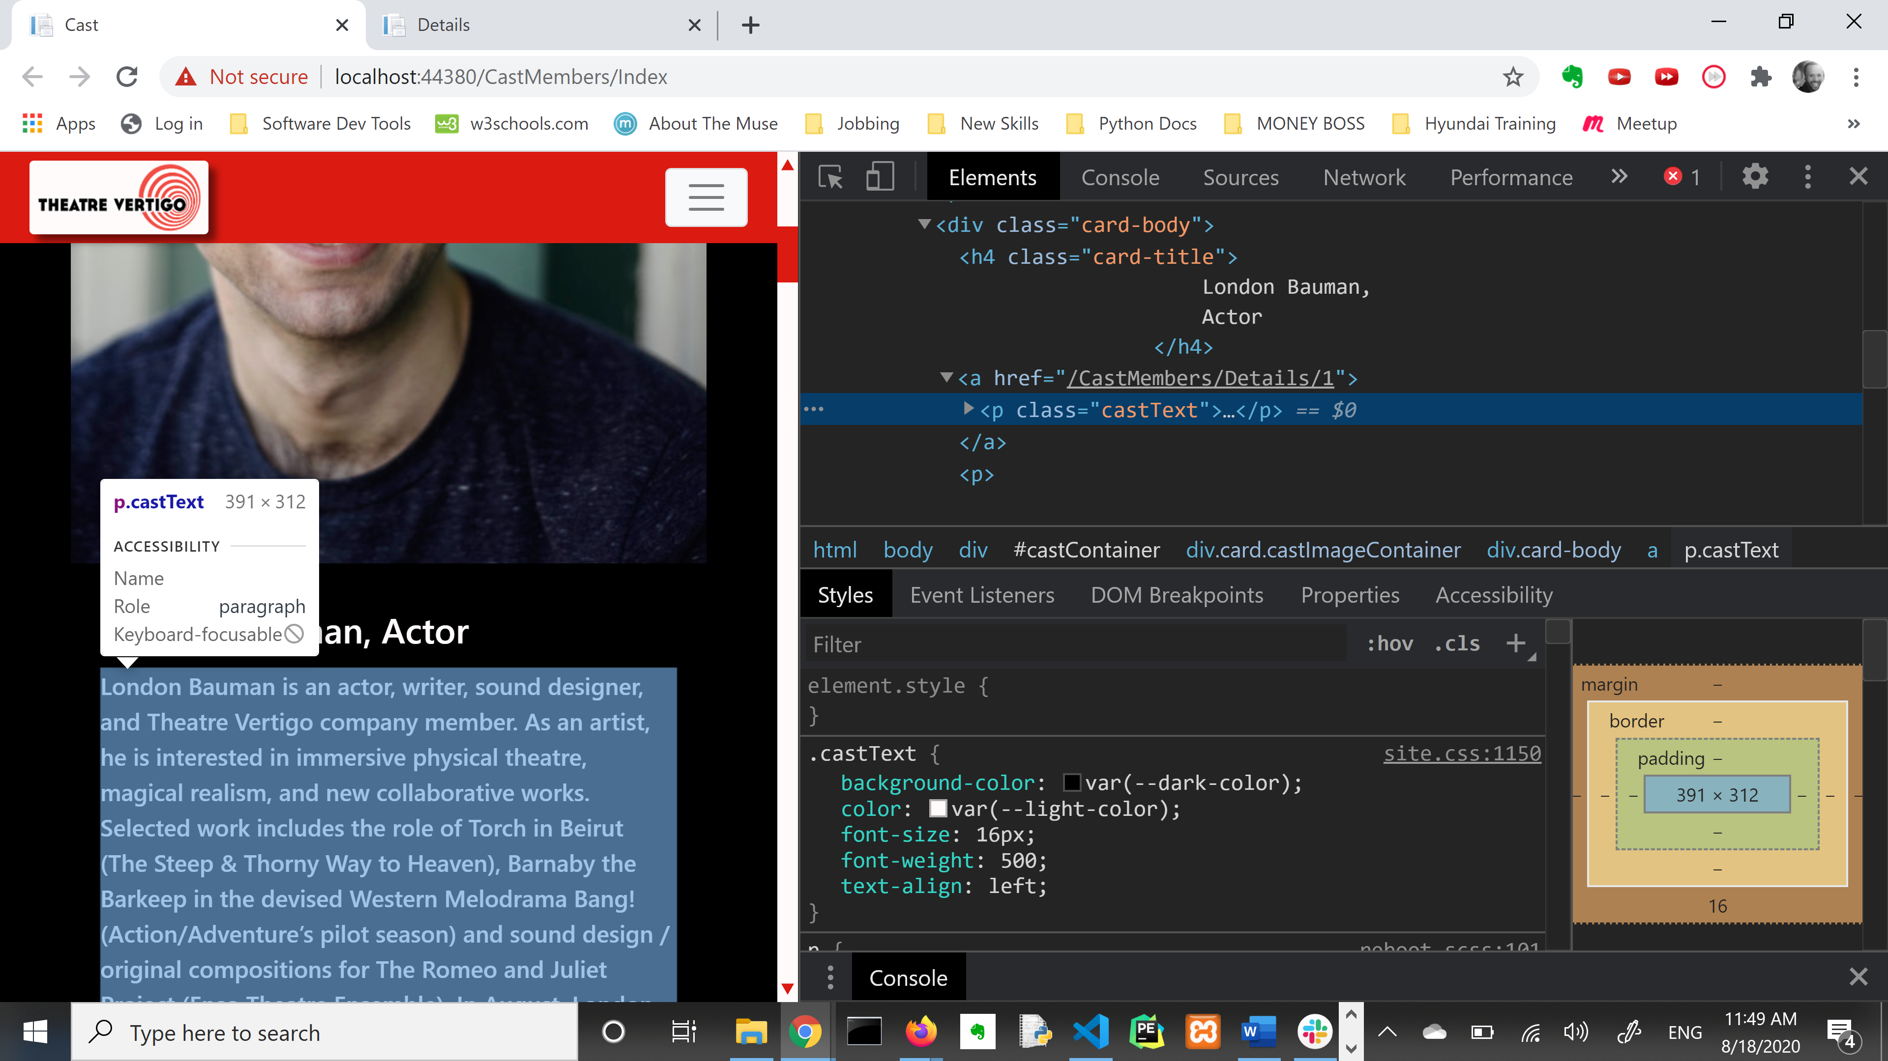
Giving all the actors a face-lift…
…that is the web page—with CSS.

Slide 23
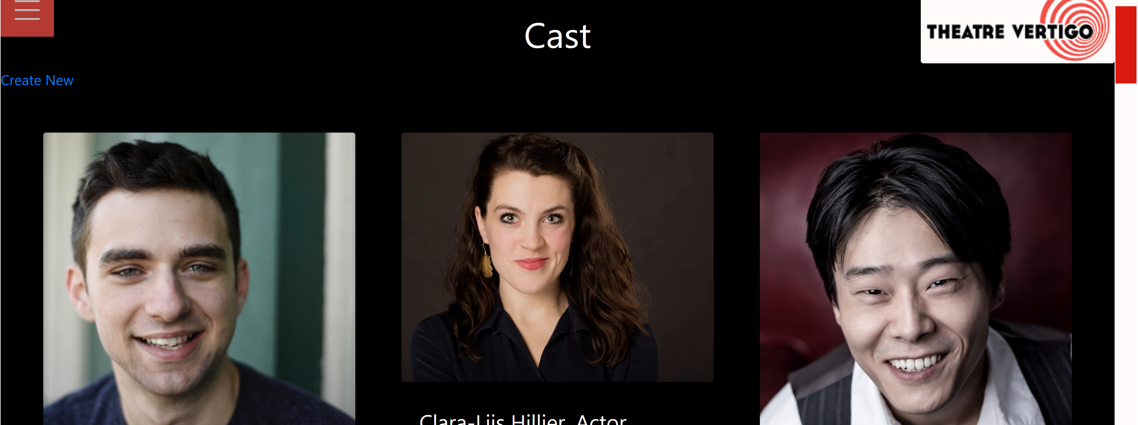
The Original Look

Slide 24
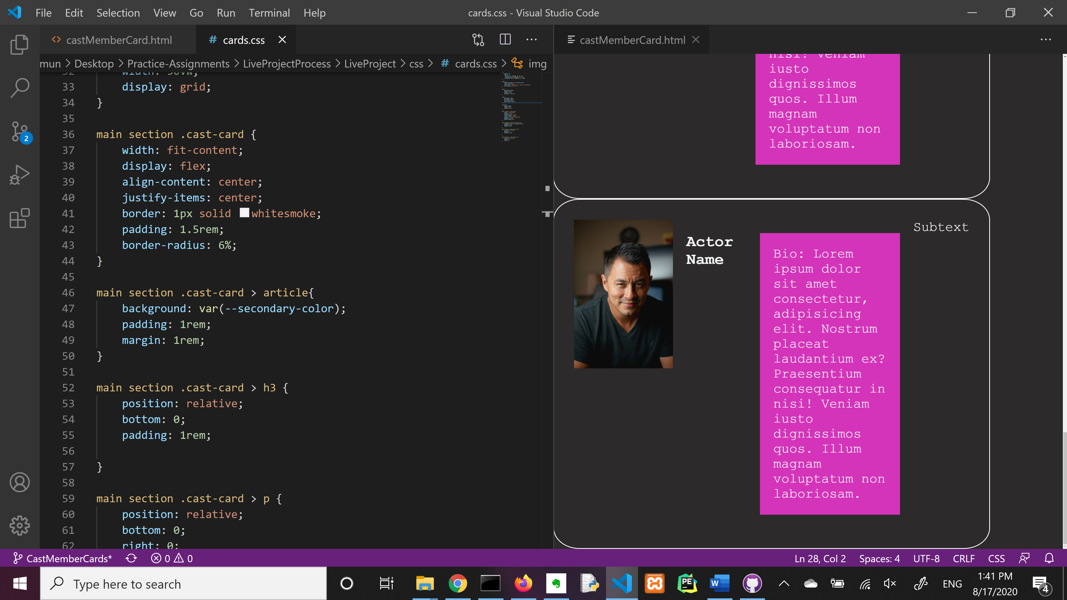
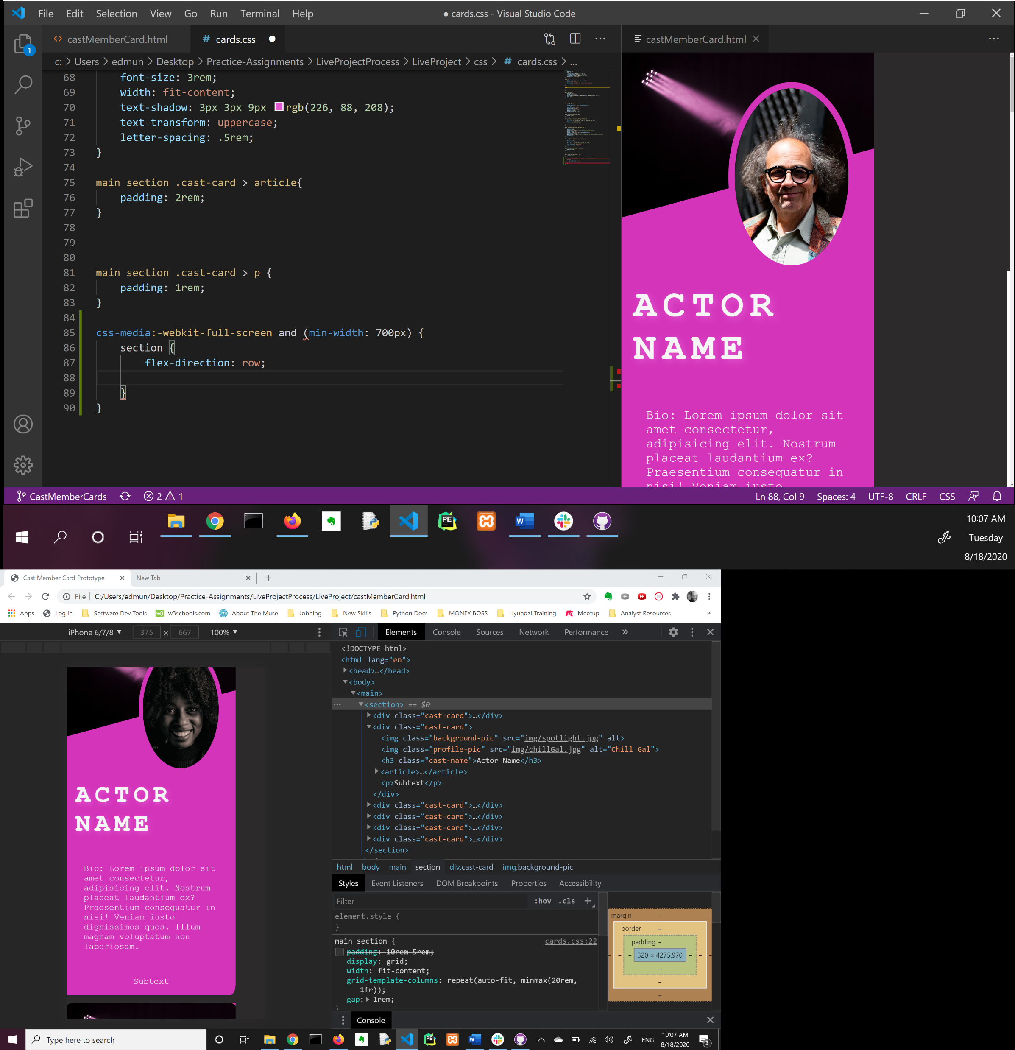
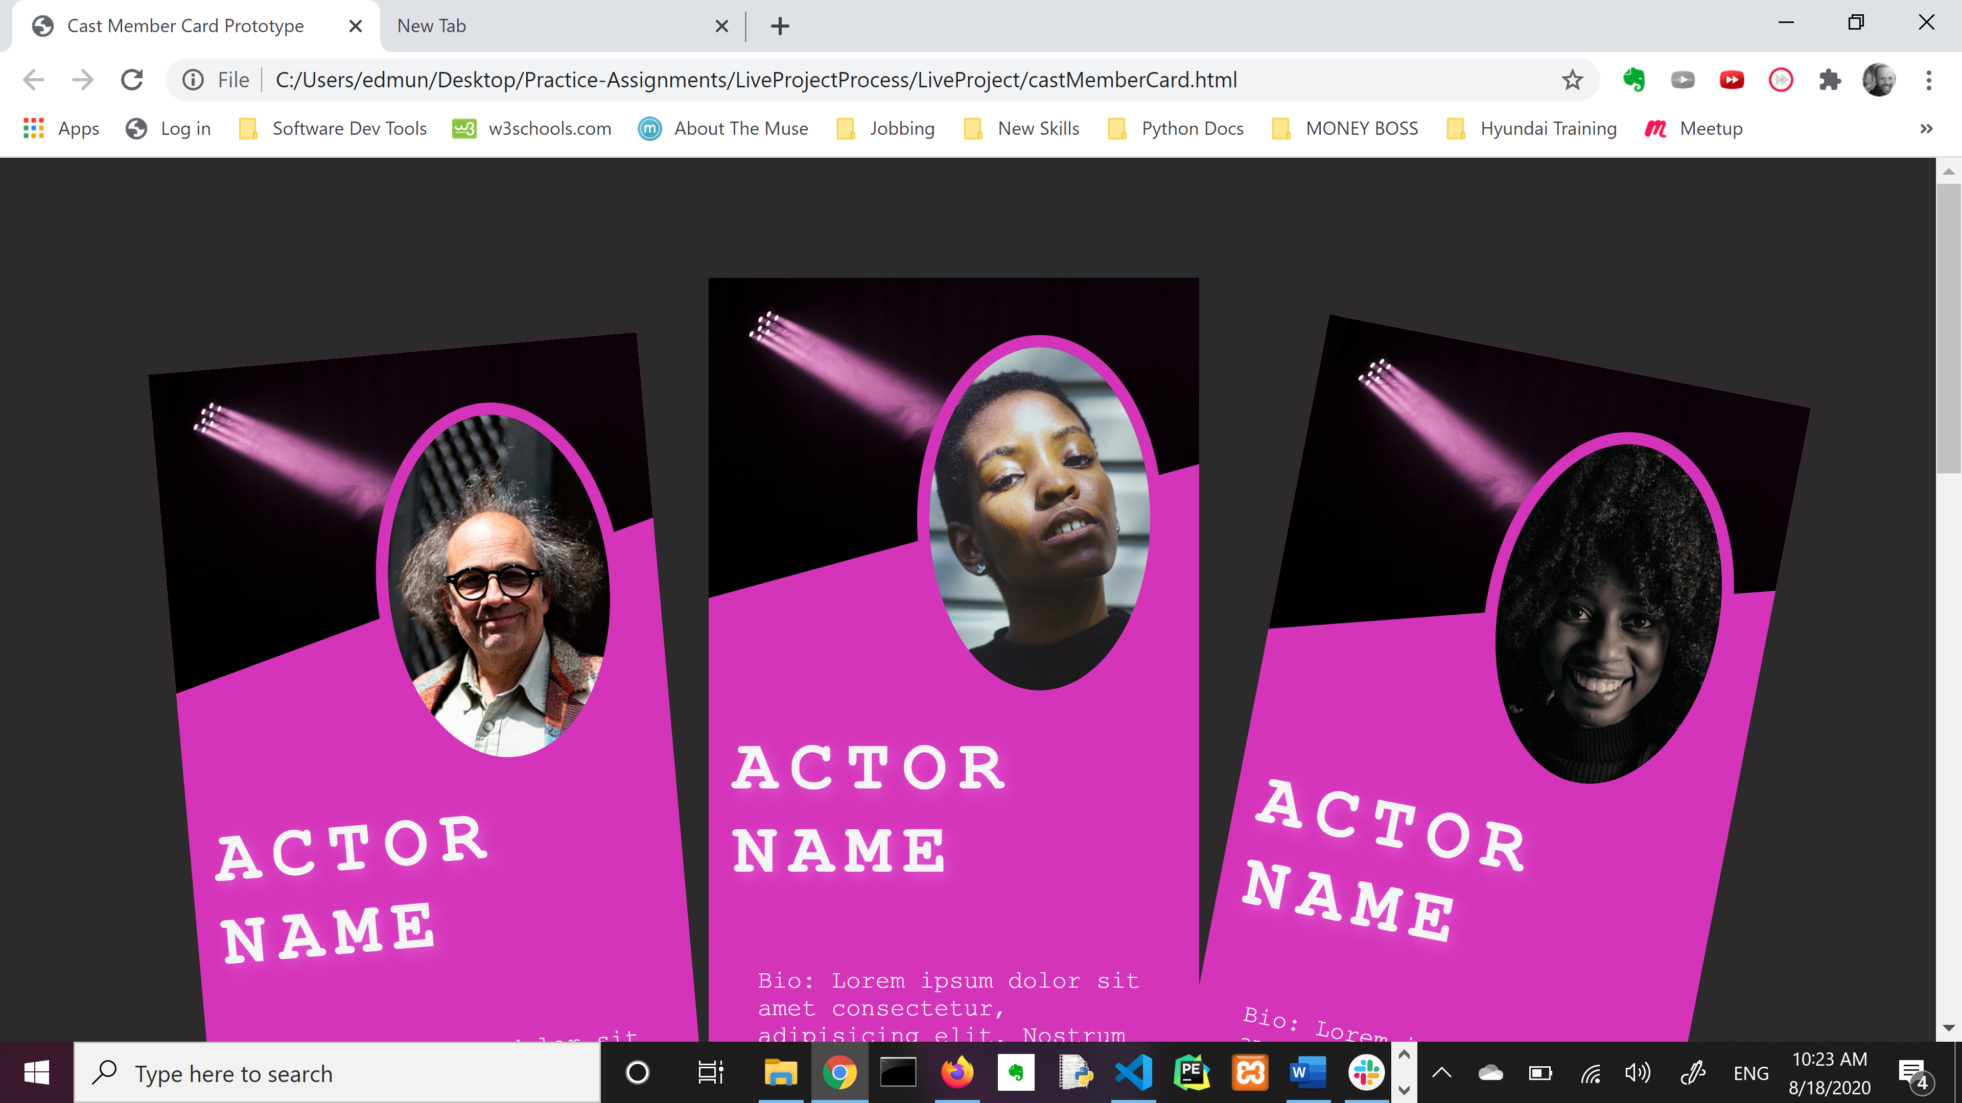
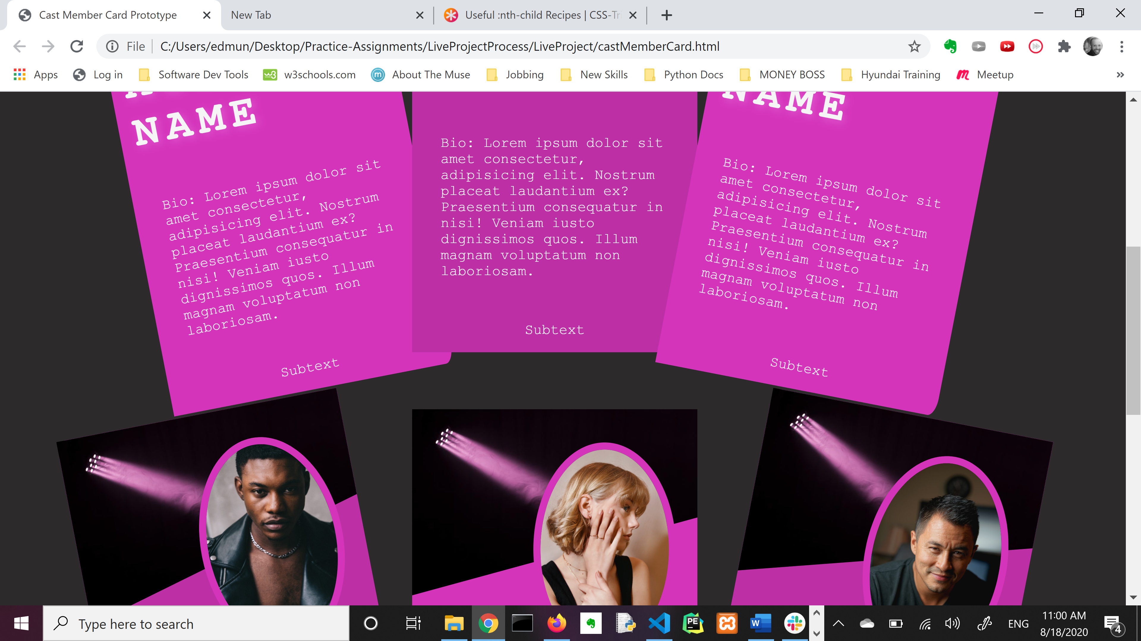
More prototyping!

Slide 25
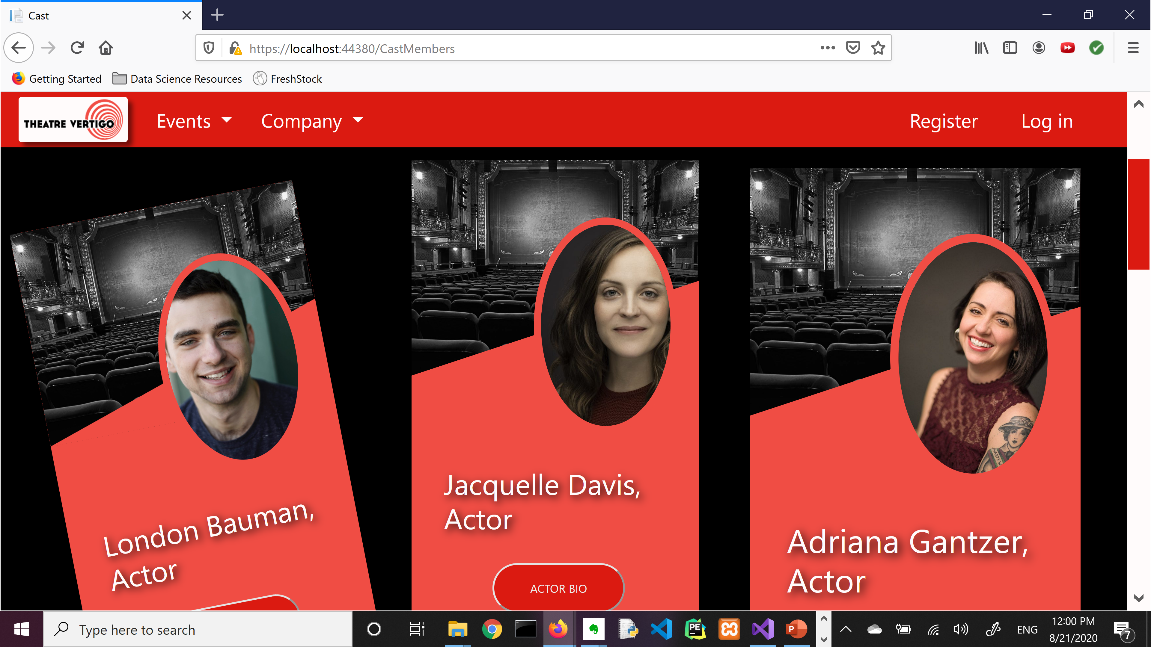
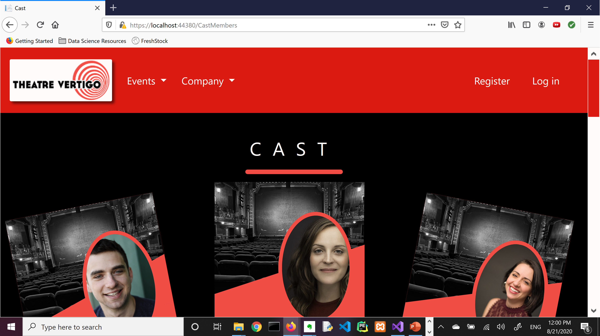
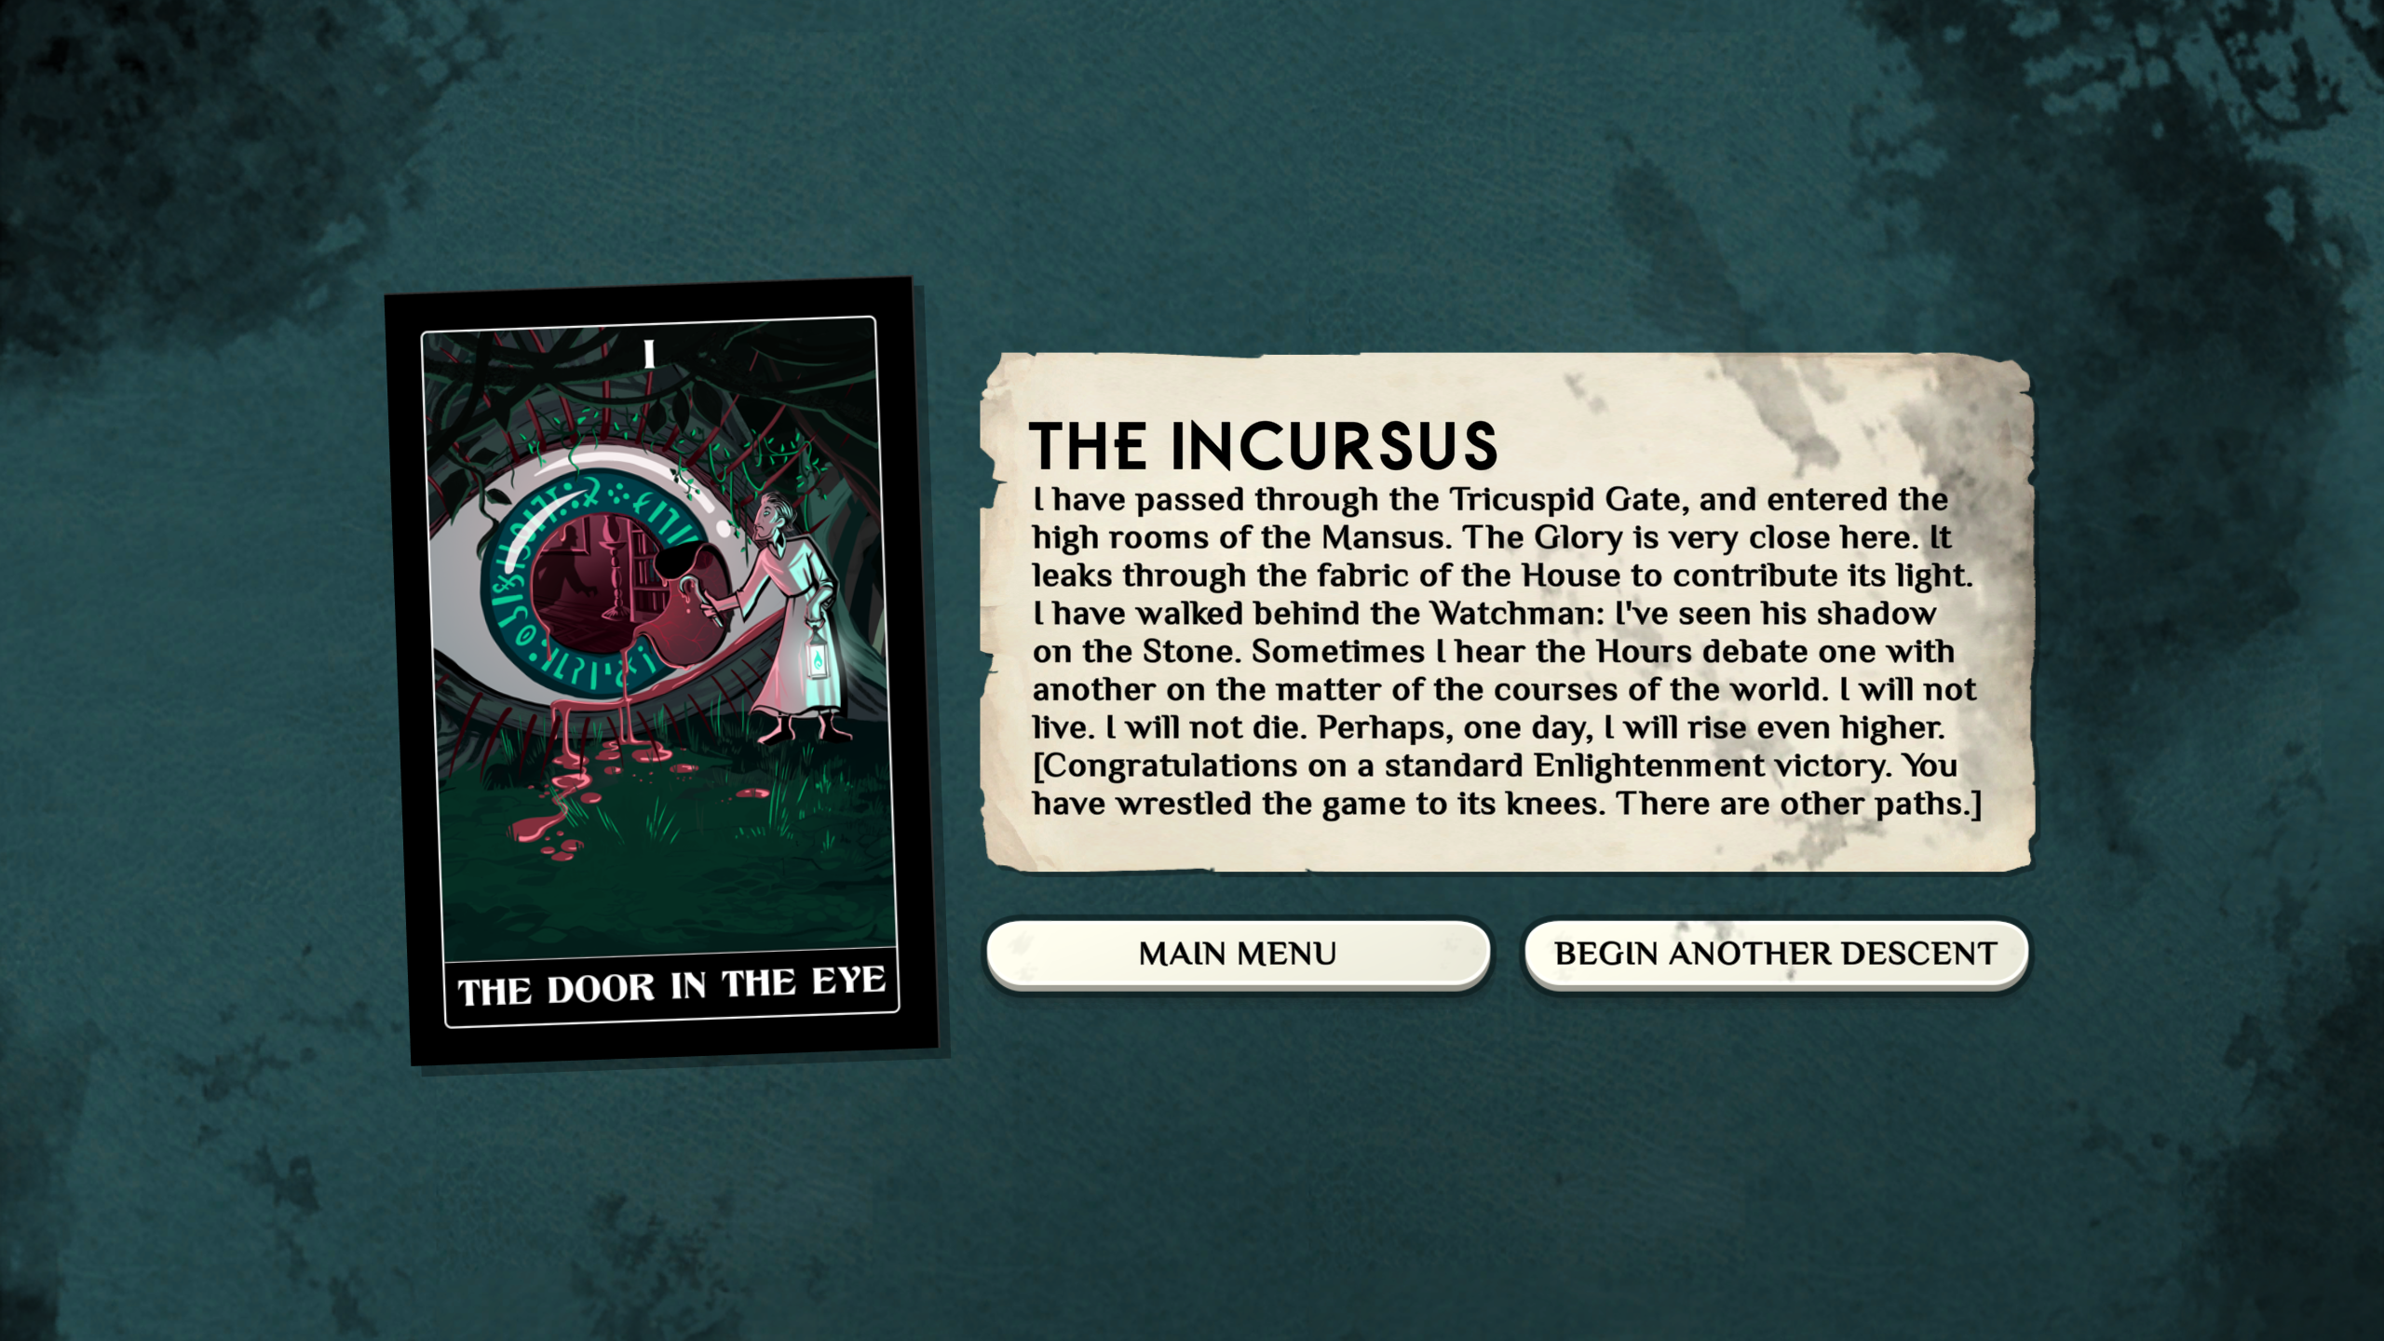
…into the project!

Slide 26
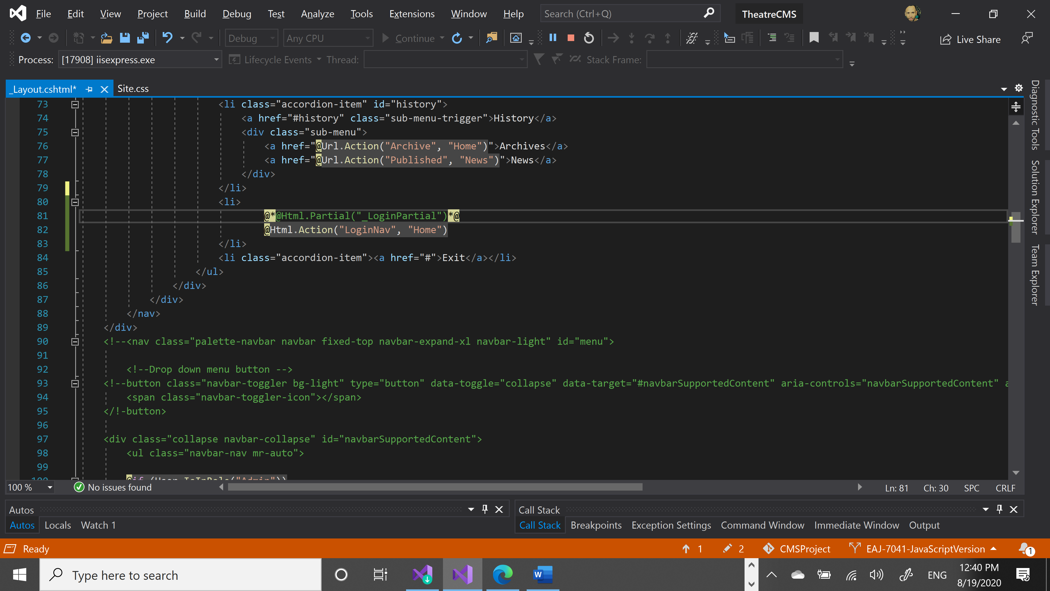
Guess who’s back?

Slide 27
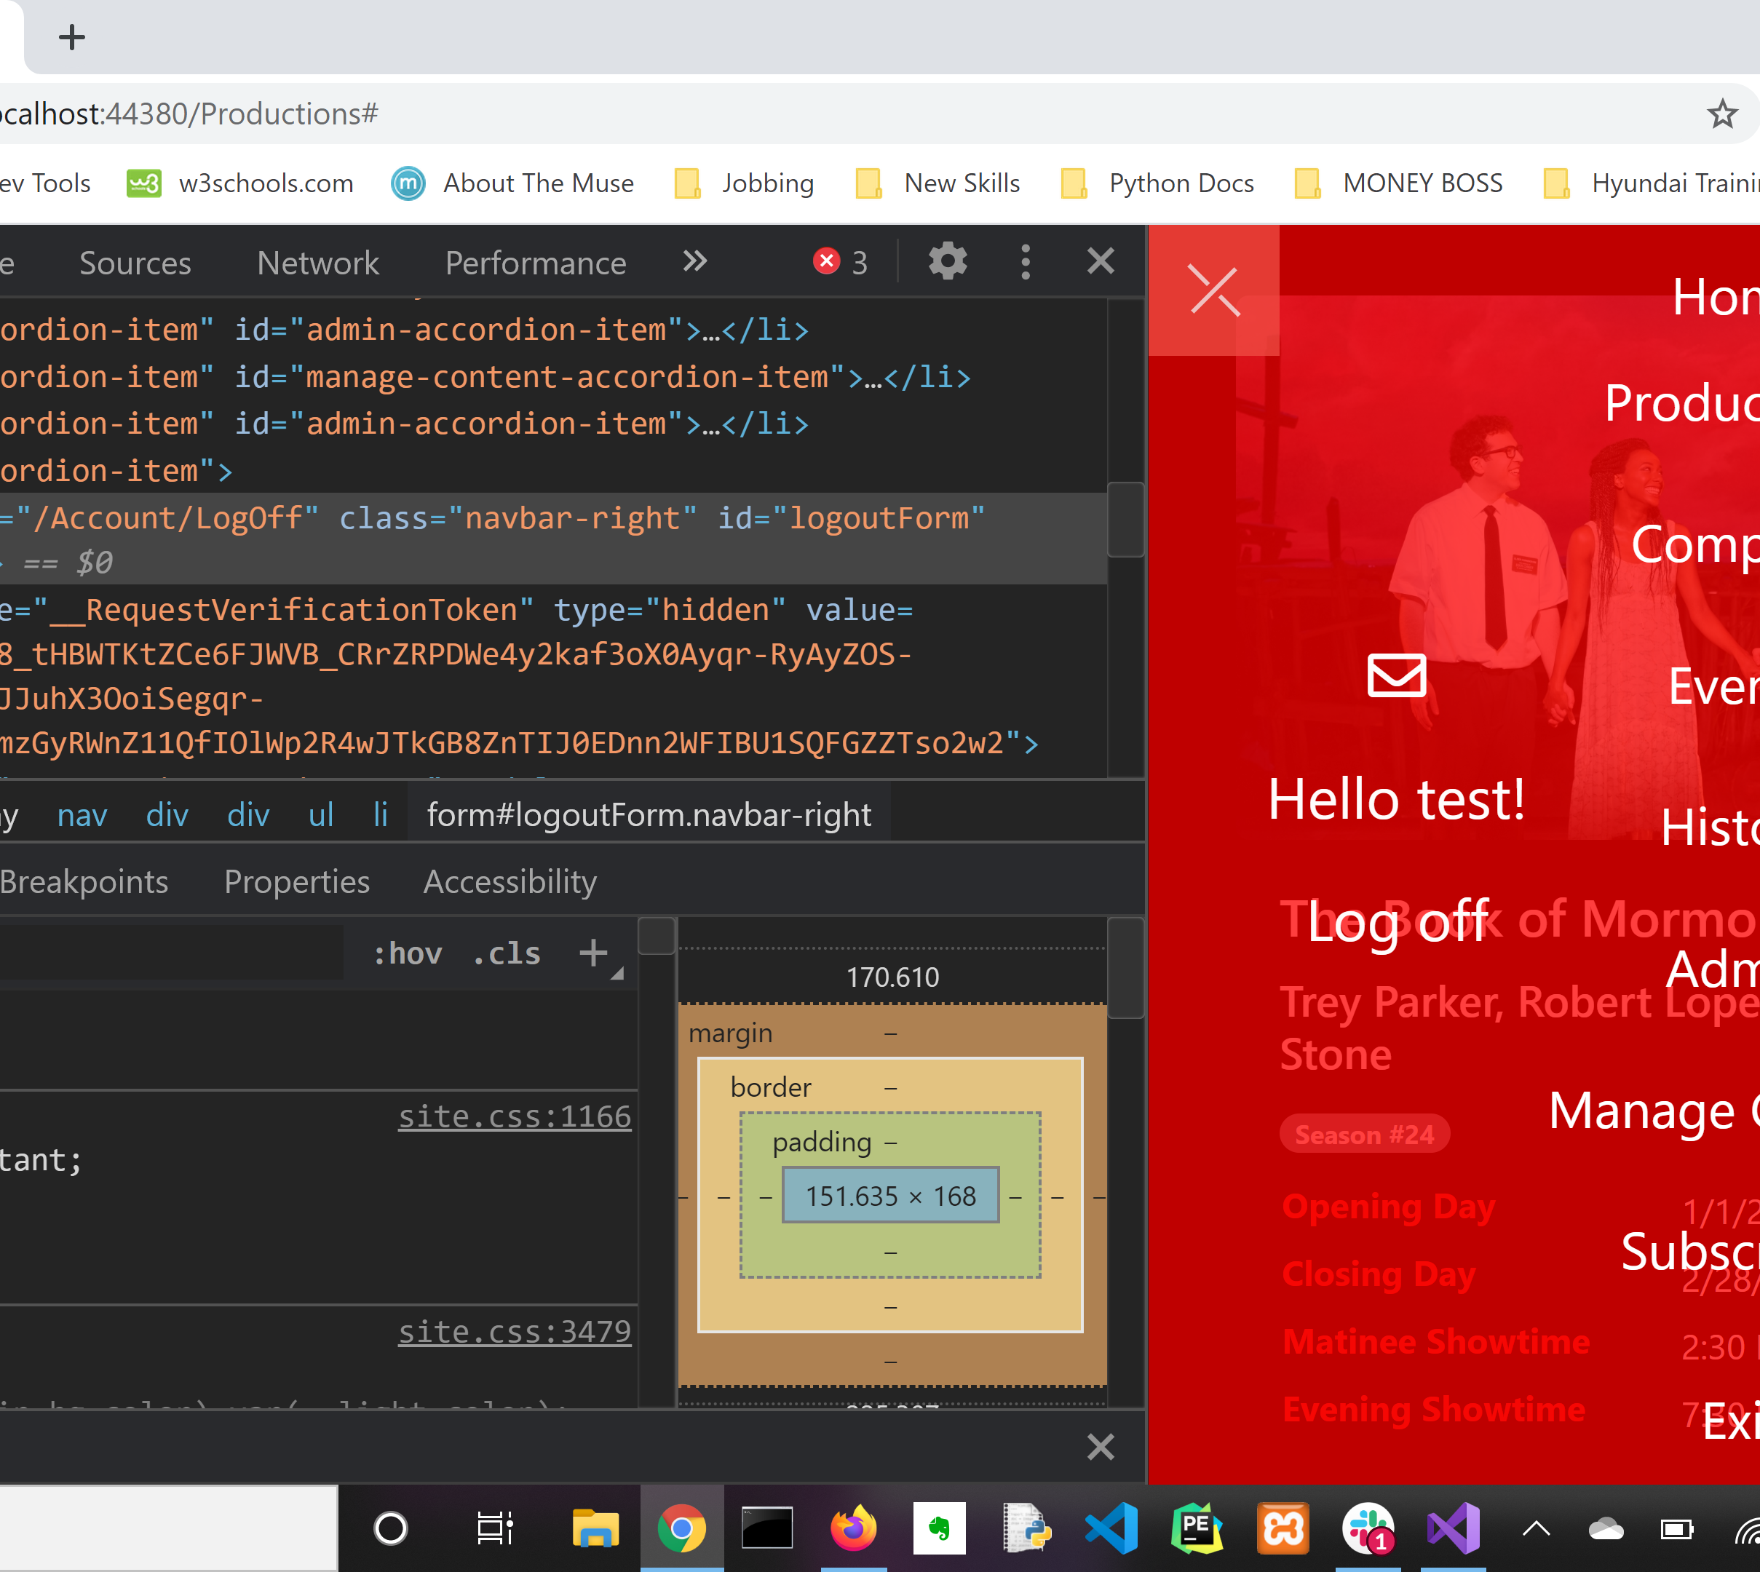
Administrative Assistance
So, in order to get the overlay into the project I had to incorporate the Admin/Subscriber functionality from the originally navbar.
Which promptly sent me back…

Slide 28
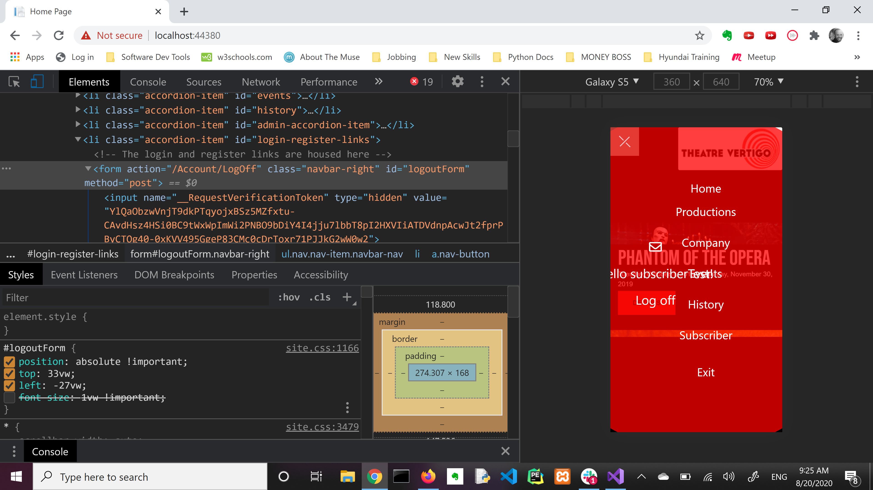
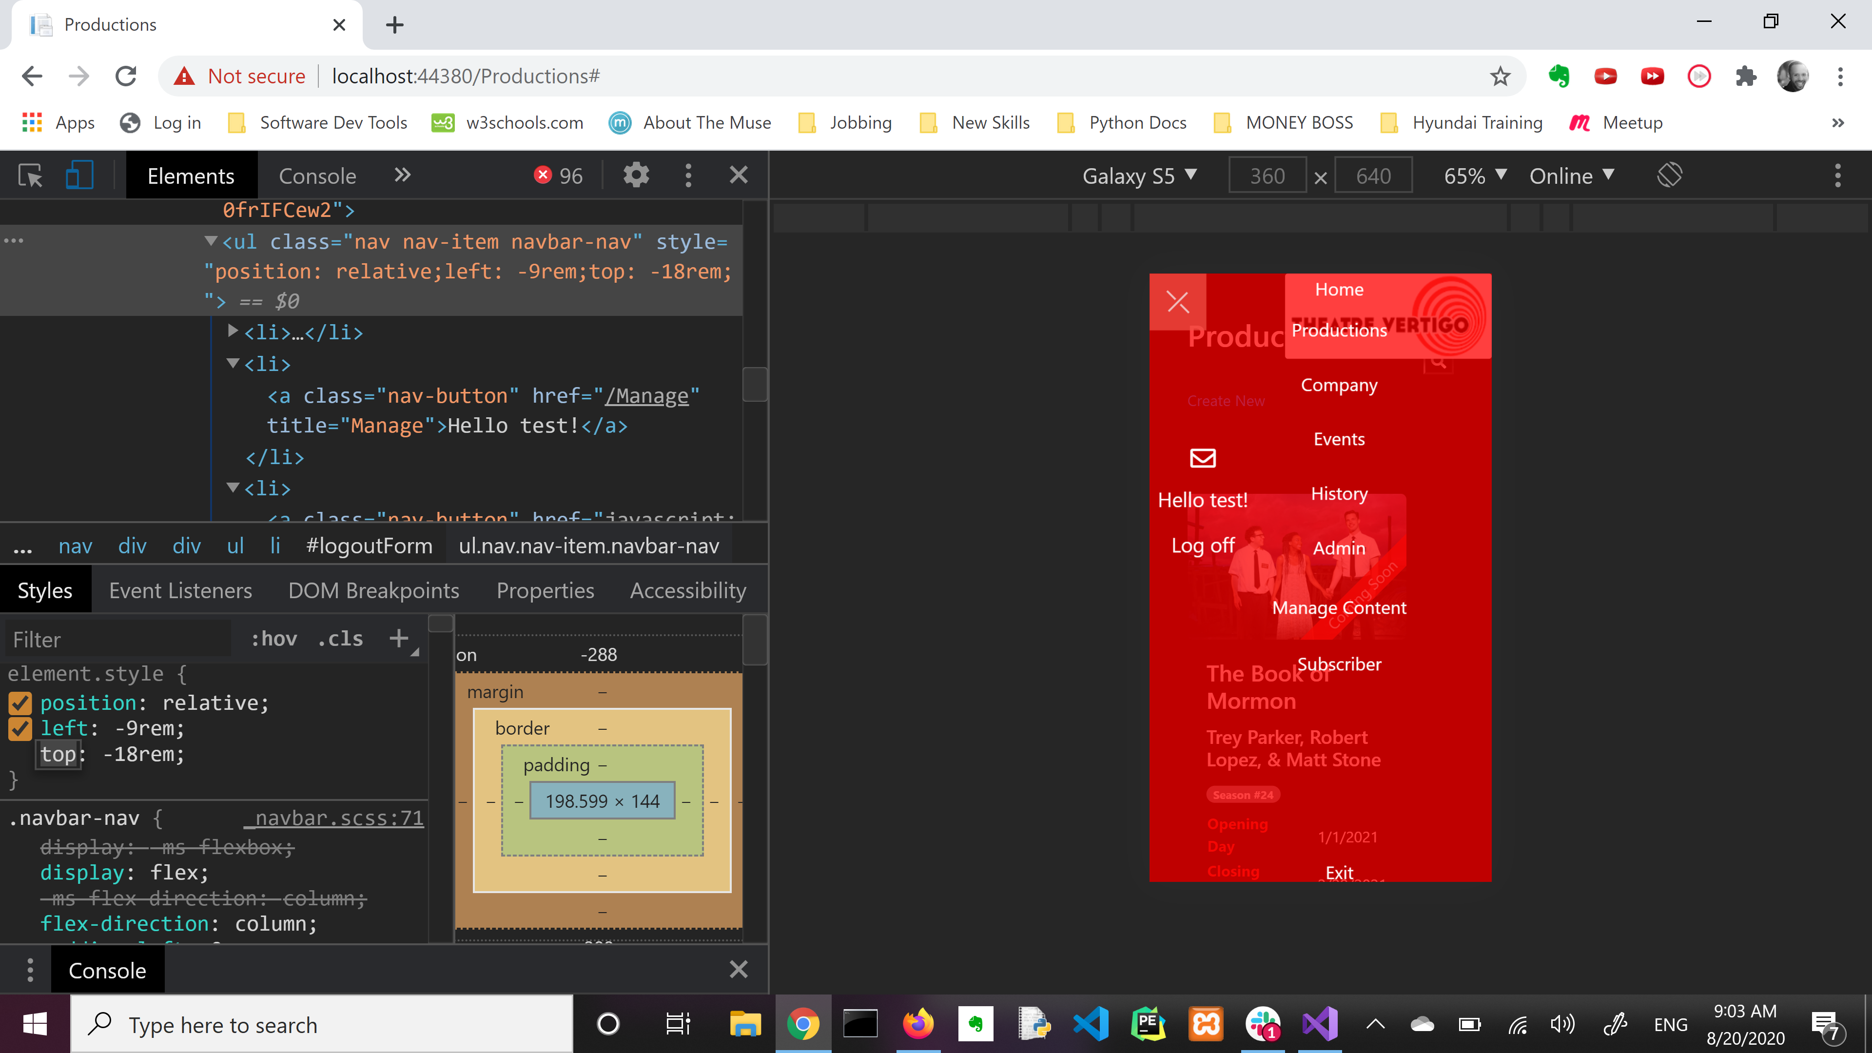
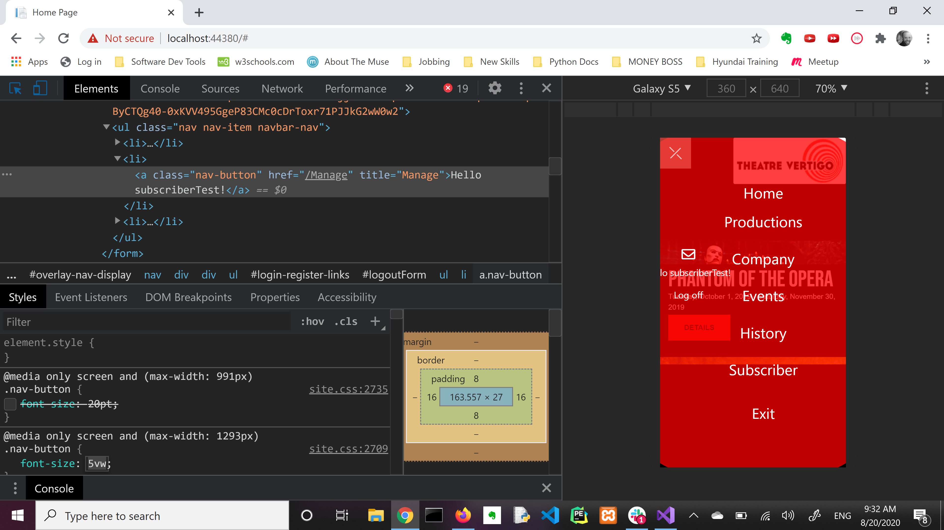
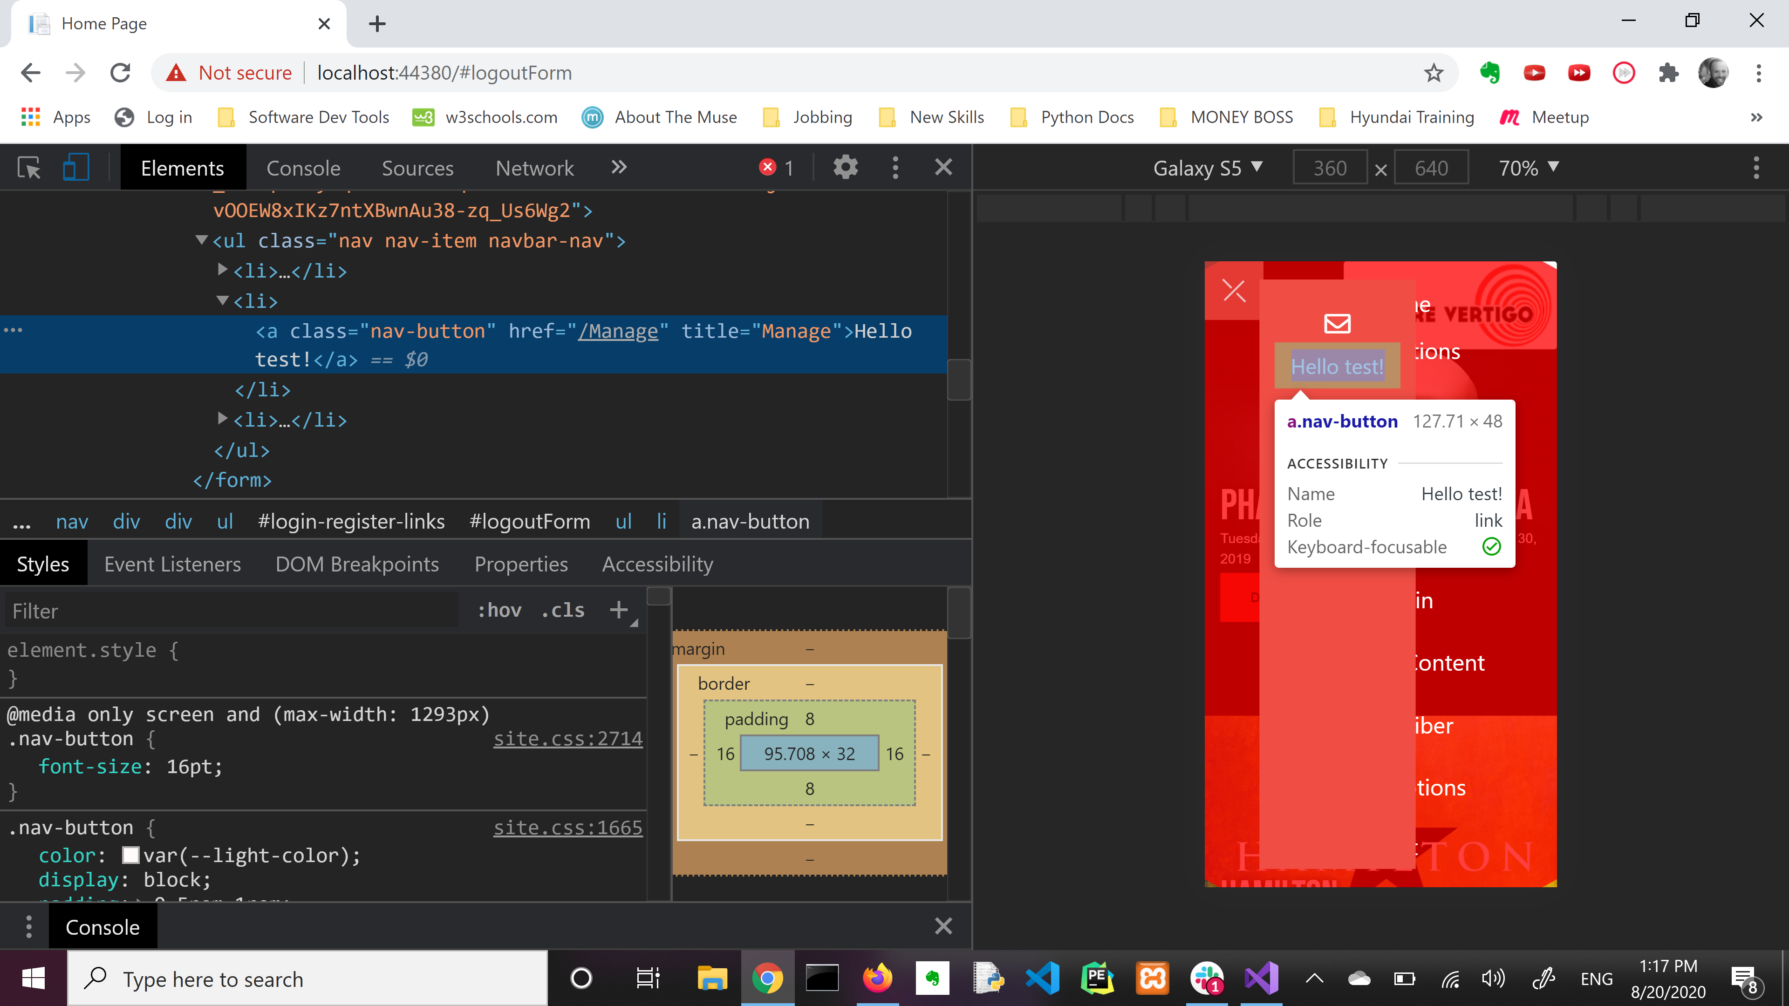
HELL
HELL
TO CSS POSITIONING HELL
TO CSS POSITIONING HELL

Slide 29
In the words of the immortal American Spiritual Song…

Slide 30
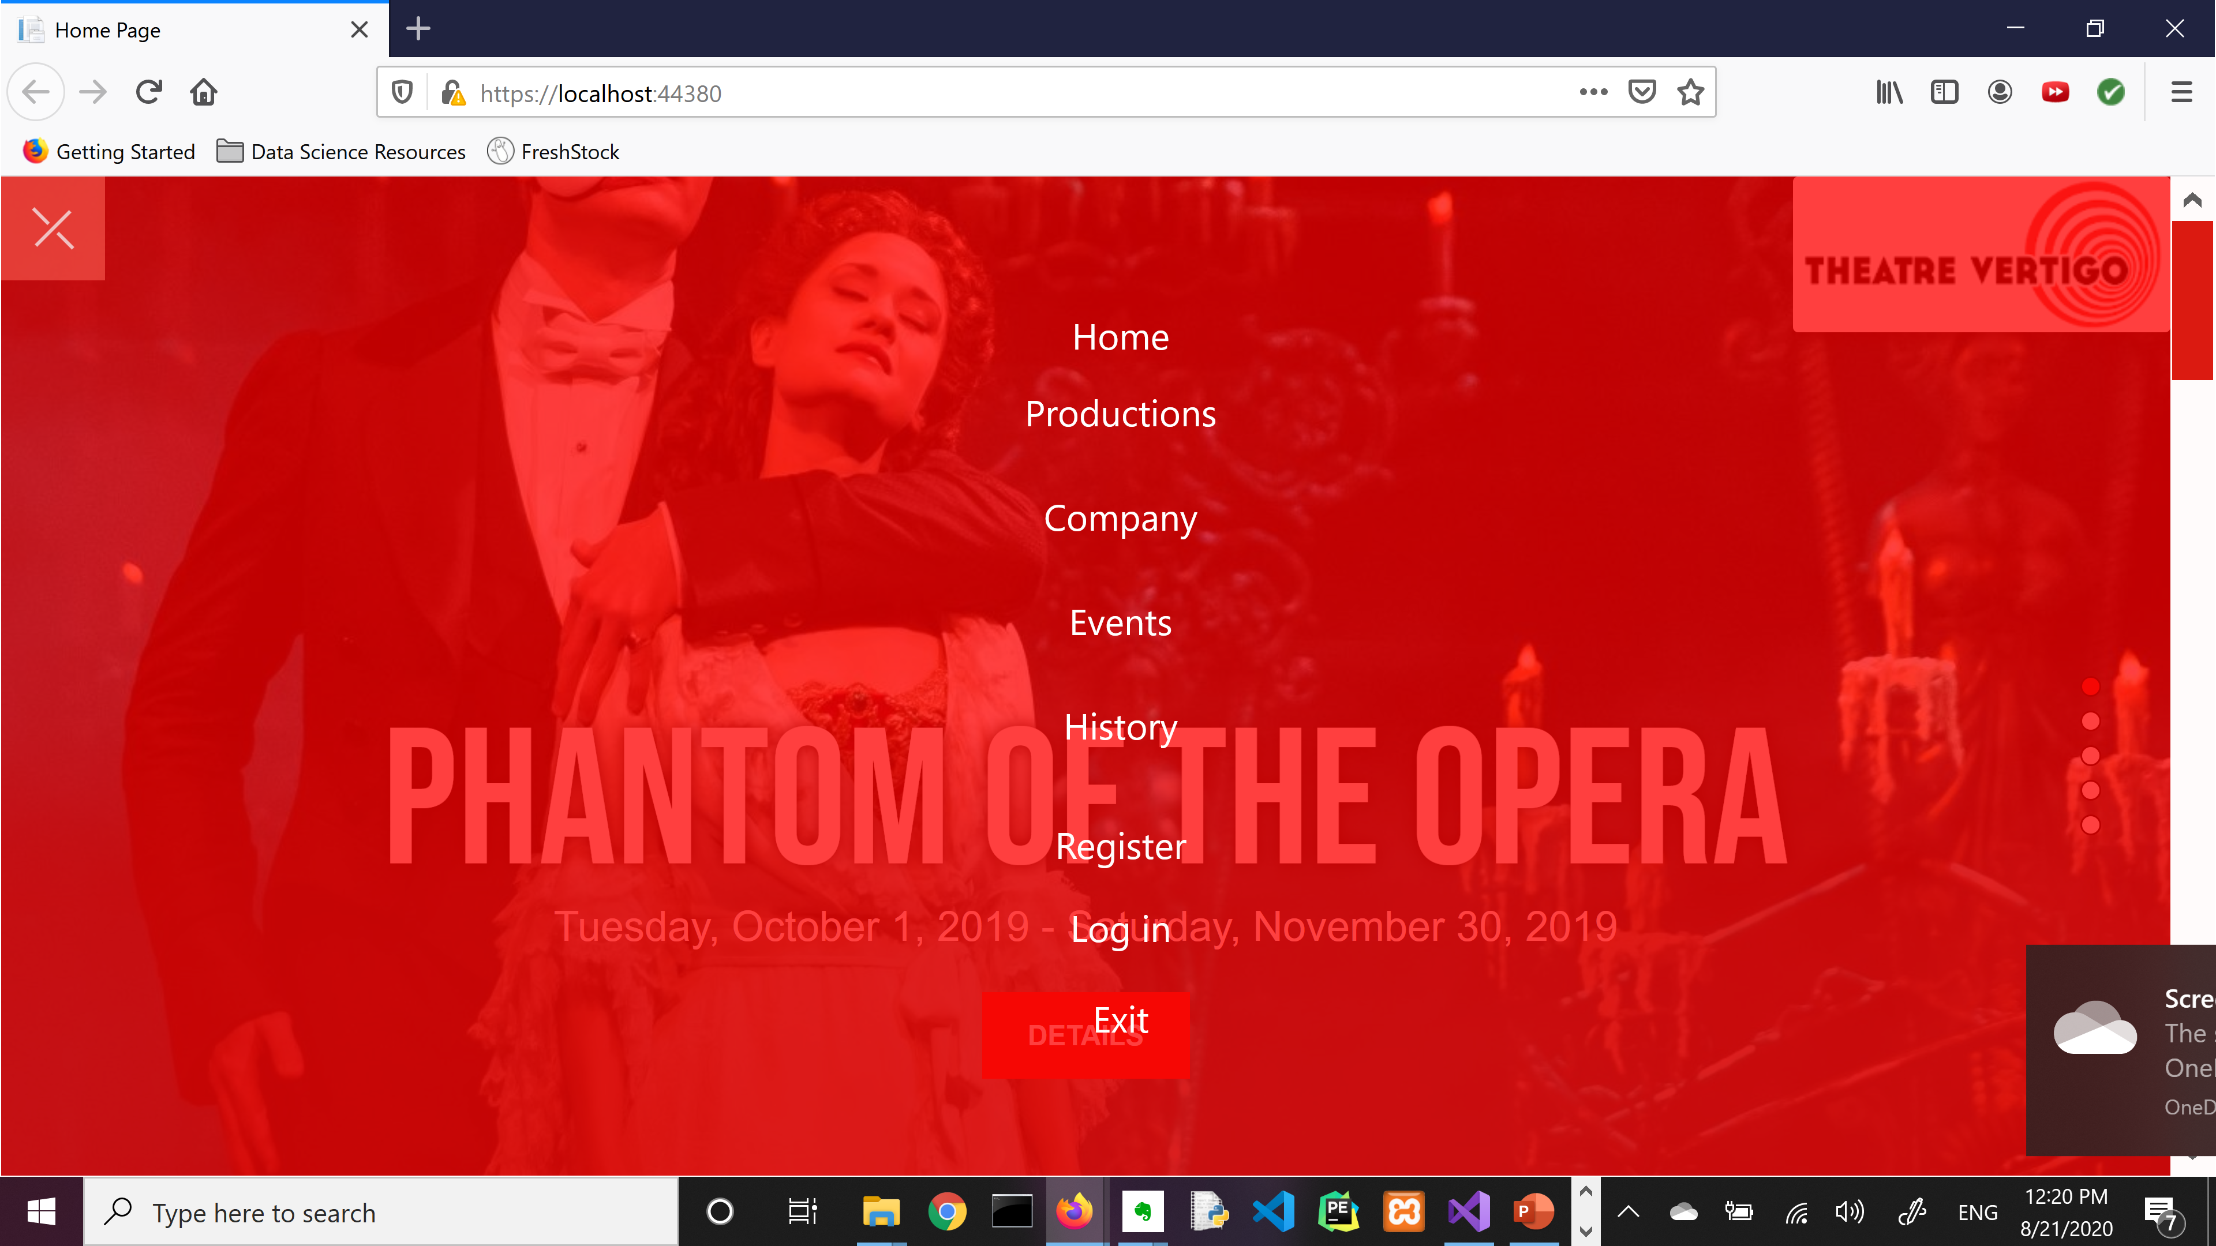
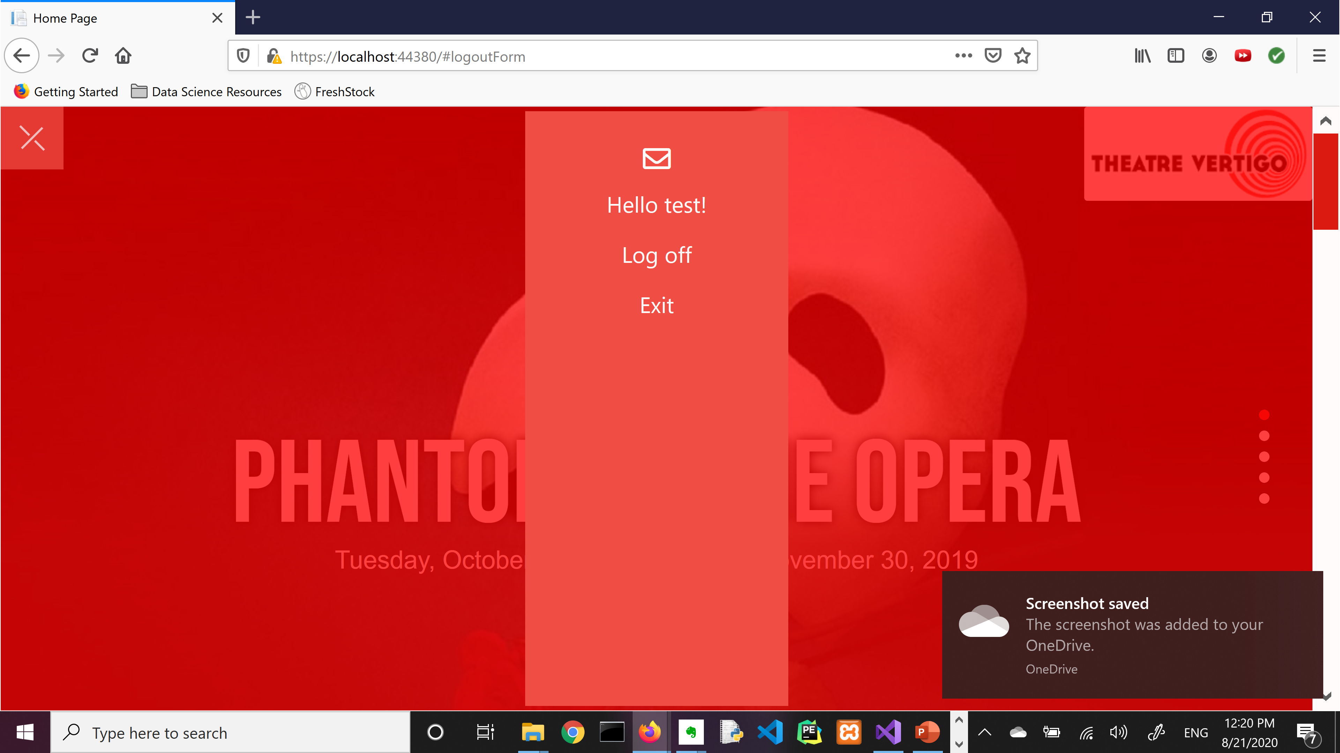
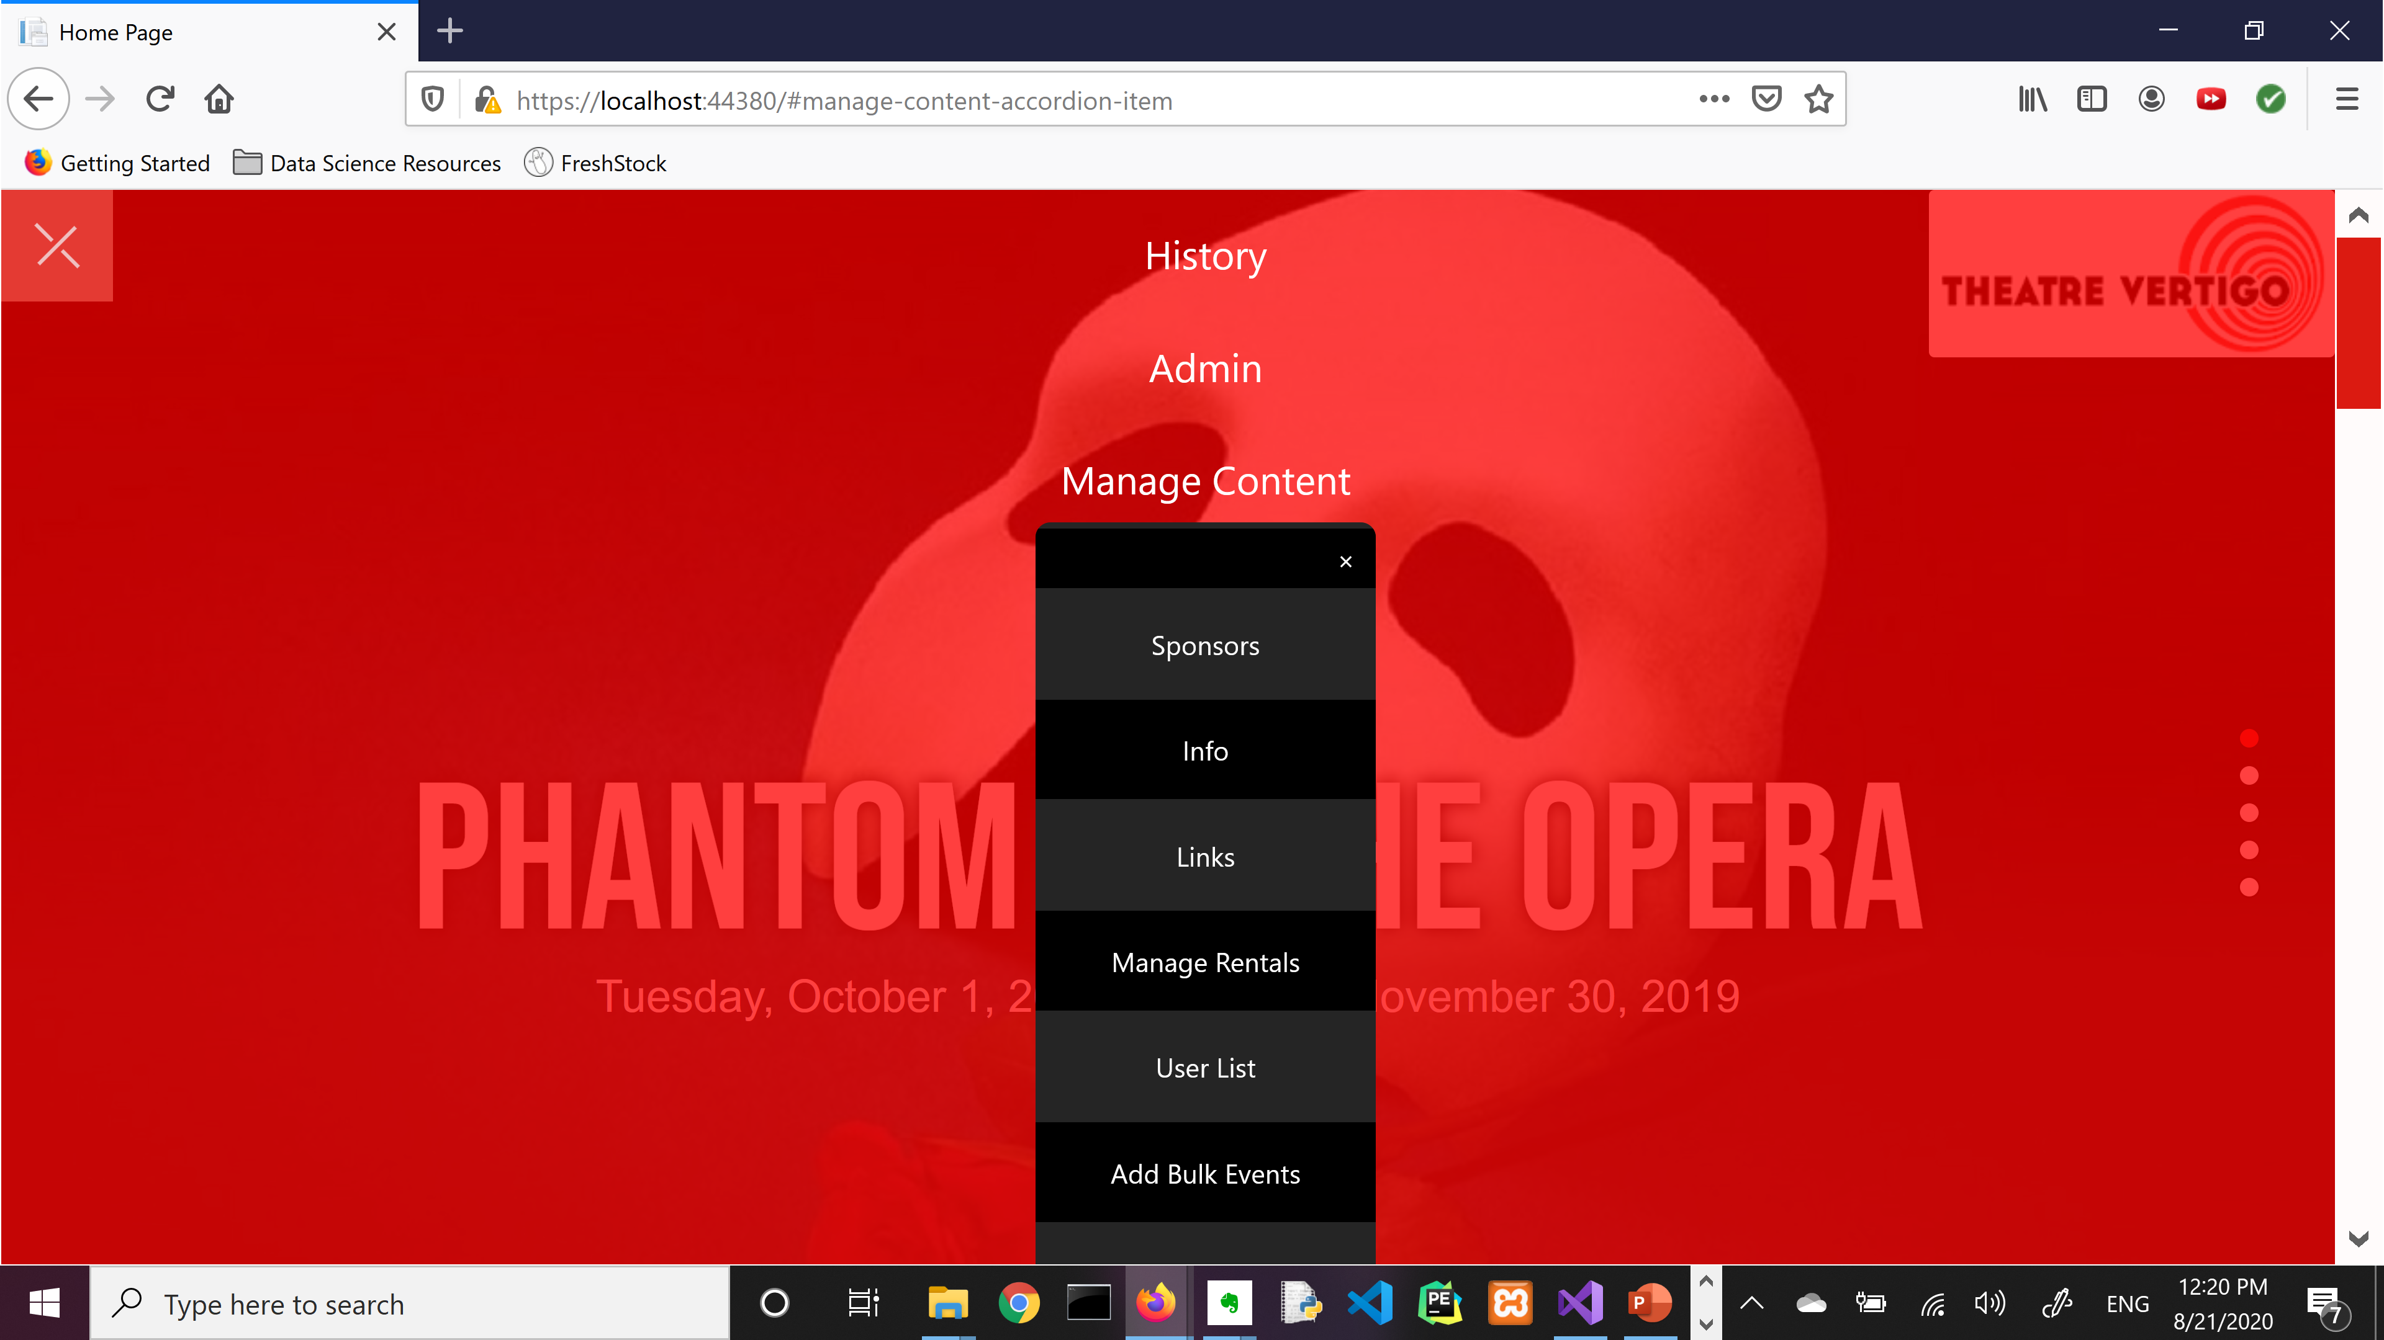
WE SHALL OVERLAY…
…some day!

Slide 31
Special thanks to the CMS directors for letting me join this amazing project. I’ve learned so much!
- me

